Slide 1
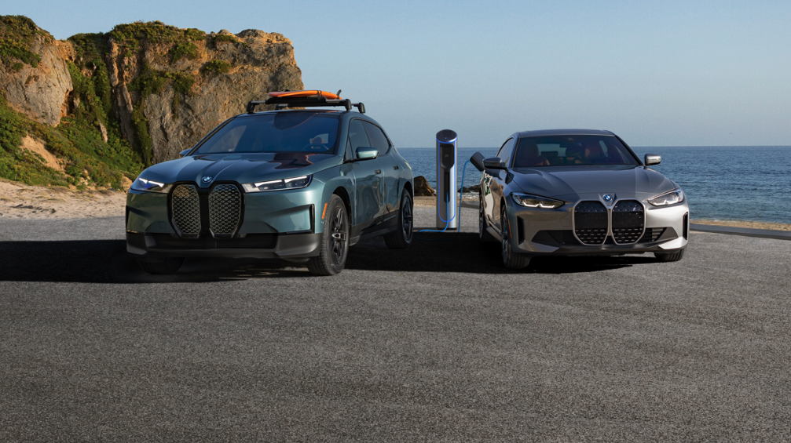

SSE
2024
BI-WEEKLY REPORT
JULY 2024

Slide 2
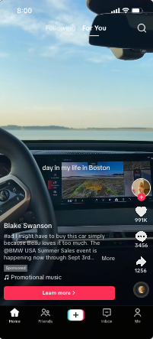
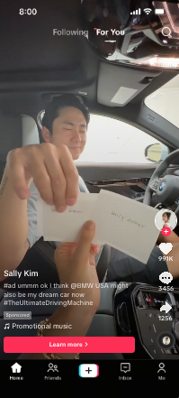
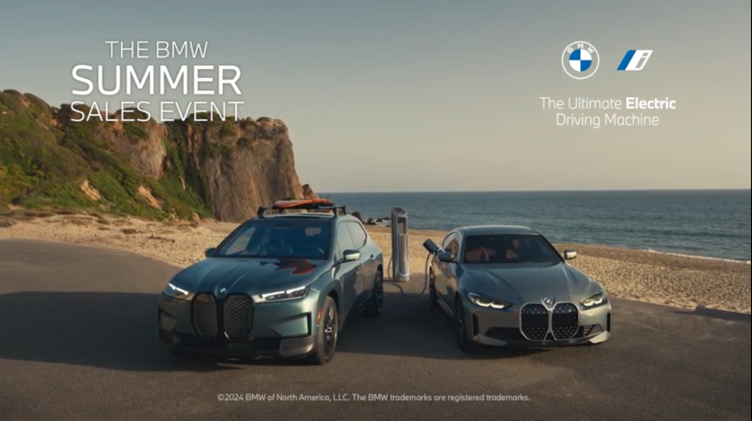
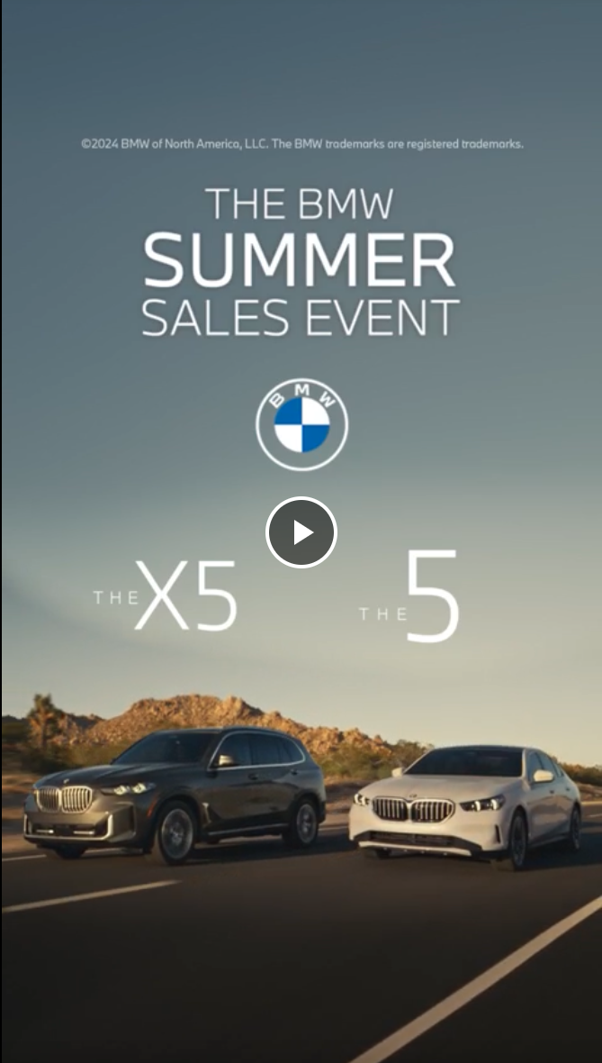
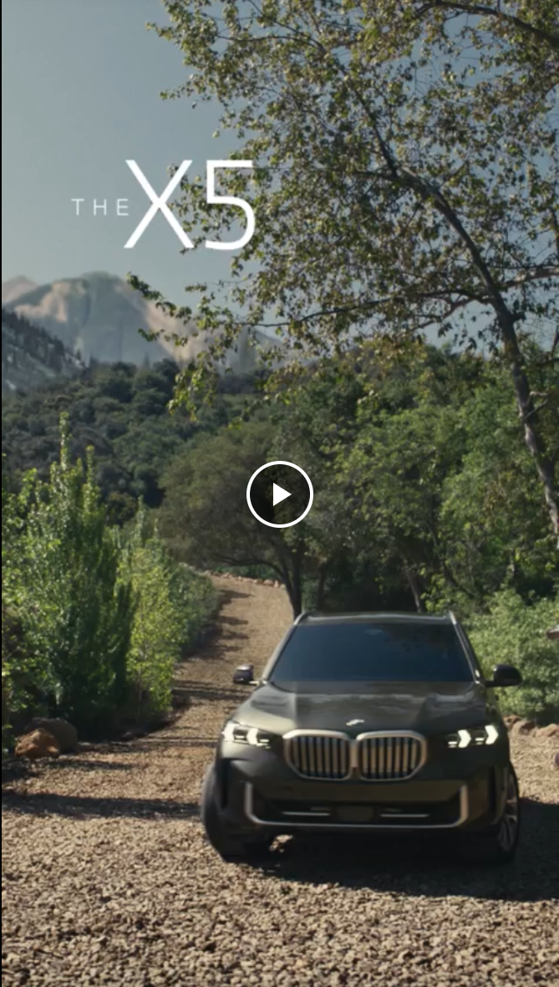
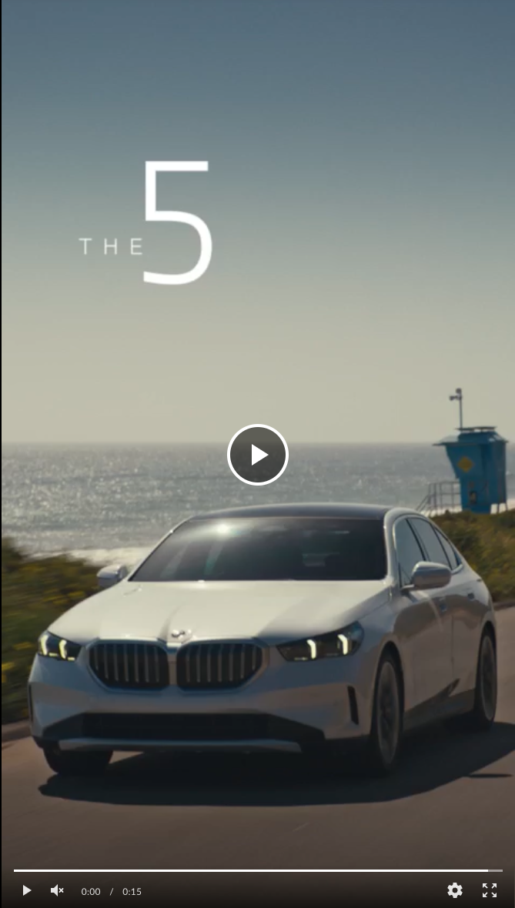
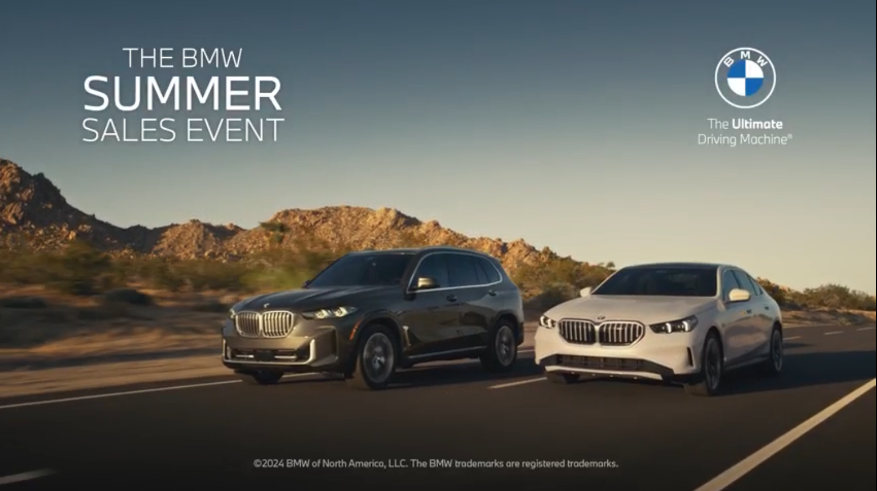
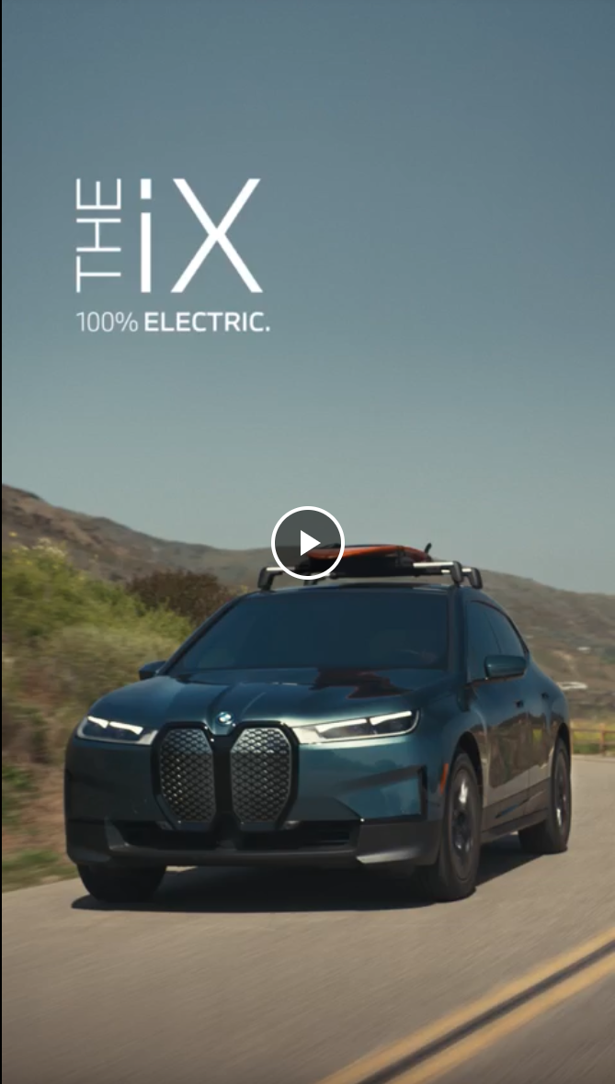
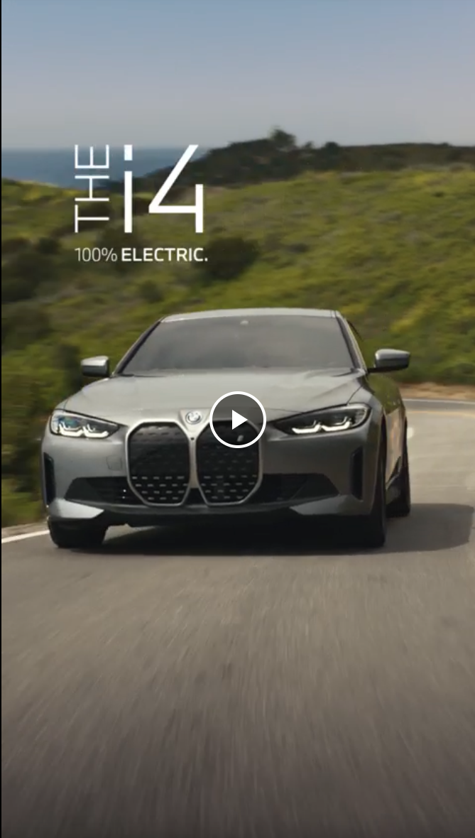
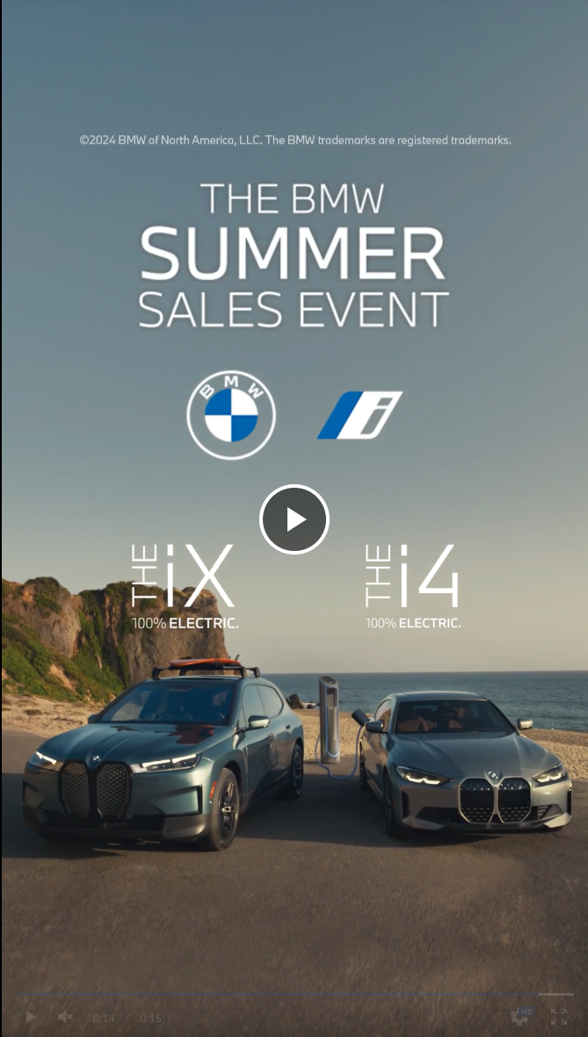
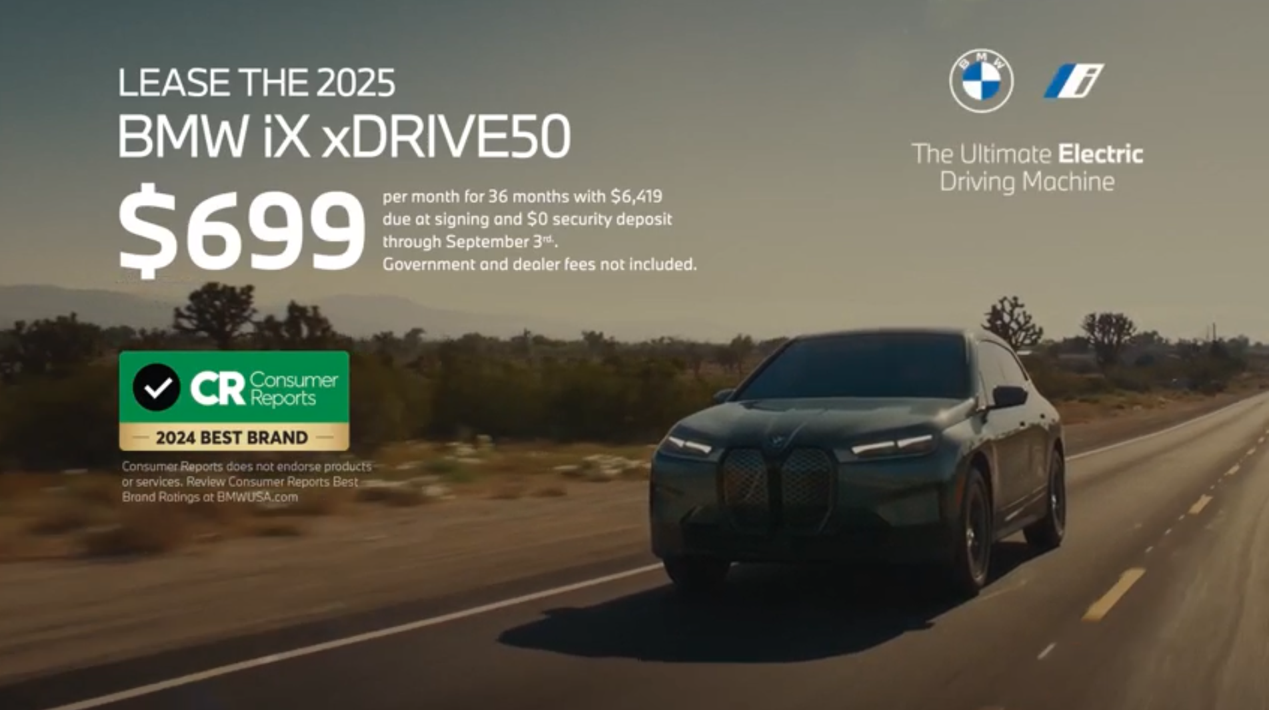
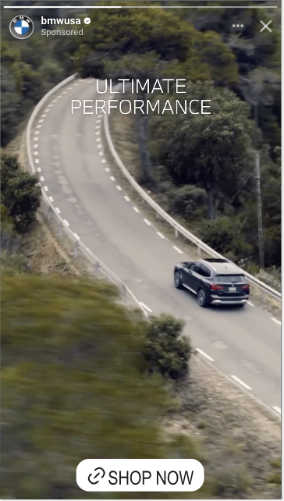
SSE 2024 | CAMPAIGN timeline
Sounds of Summer Launch:
YouTube Organic
Organic & Paid Social
SSE Email 1
SSE Email 2
SSE Email 3
Amazon Optimization to Display
TikTok Creator
Paid Launch
iX Organic Social Post
WE ARE HERE
SSE Launch
7/12
7/19
7/25
8/4
8/11
8/14
8/25
9/3
Campaign Ends
7/2
7/8
7/14
7/18
8/9
8/13
8/21
Linear Partners
COPA/EURO
CTV
OLV + YouTube
Audio
OOH
Organic & Paid Social
Search
Organic YouTube
Hot Mic Moment
Organic & Paid Launch:
YouTube ​
Social
COPA/EURO Concludes
Consideration ICE support shift from X5 (15%) to 5S (30%)
Stop sale
T2 PMAX optimizations made*
X5 Organic Social Post
w/o 7/15
8/1
T1 & T2 Pinterest
T2 TikTok
T2 Audio: Spotify & Pandora
7/22
Swap to August offer creative across tiers. Inclusive of $699 iX National Offer
8/23
EV AO i4, iX Paid Social Support Launch
X3 paid social launch (T1+T2)
Email
3
Conquest & Winback
Email
3 re-send
Conquest & Winback
Email
3 re-send
Conquest & Winback
Email
1
Email
2
Email
3
Prospects & Owners
2024 SSE Campaign | Bi-Weekly Report #4

Slide 3
Campaign Interacting web visits are outpacing last year, while kbas ARE slowly closING the year-over-year gap.
How are we tracking against our targets 7/2-9/3
CAMPAIGN TIMELINE PACING (7/2– 9/3):
BUDGET PACING (7/2-9/3):
84% of timeline
85% of budget*
DRIVE AWARENESS
INCREASE PRIMARY VEHICLE INTEREST
ENCOURAGE LOW FUNNEL ACTIONS
VIDEO VIEWS
22.4M
11.2% of 199M Total Campaign Projection
INTERACTING SITE VISITS
2.1M
+32% vs. 1.6M SSE ‘23
3% of 2.4M Target
BYO STARTS
293K
-44% vs. 519K SSE ‘23
BYO COMPLETES
158K
-45% vs. 285K SSE ‘23
INVENTORY SEARCHES
132K
-30% vs. 188K SSE ‘23
LEAD SUBMISSIONS
3,915
-51% vs. 7.9K SSE ‘23
10% of 39K RTF July + August NSC Lead Target
OLV VIEW RATE
68%
+38% pts vs 30% Campaign Projection
INTERACTING VISIT RATE
79%
+2.7% pts vs. 76% SSE ‘23
BYO START RATE
14%
-19% pts vs. 33% SSE ‘23
BYO COMPLETION RATE
54%
-1.1% pts vs. 55% SSE ‘23
INV. SEARCH RATE
6.4%
-5.7% pts vs. 12% SSE ‘23
LEAD SUB. RATE (%)
0.19%
-0.32% pts vs. 0.51% SSE ‘23
REMARKETING + RETARGETING AUD. SIZE
~61.5M
Since Launch
i4 GOOGLE SEARCHES
-4%
Since Launch
iX GOOGLE SEARCHES
-5%
Since Launch
5 SERIES GOOGLE SEARCHES
+3%
Since Launch
X5 GOOGLE SEARCHES
+3%
Since Launch
Source: Workspace: [w] Summer Sales Event '24 Campaign Tracking [WIP], Traffic Segment: [v] Campaign Tracking | 2024 | Summer Sales Event '24 - All Traffic [Official], Date Range: July 3 – August 25, 2024. See Appendix for KPI and metric definitions. Search volume data is from Google Search Console
2024 SSE Campaign | Bi-Weekly Report #4

Slide 4
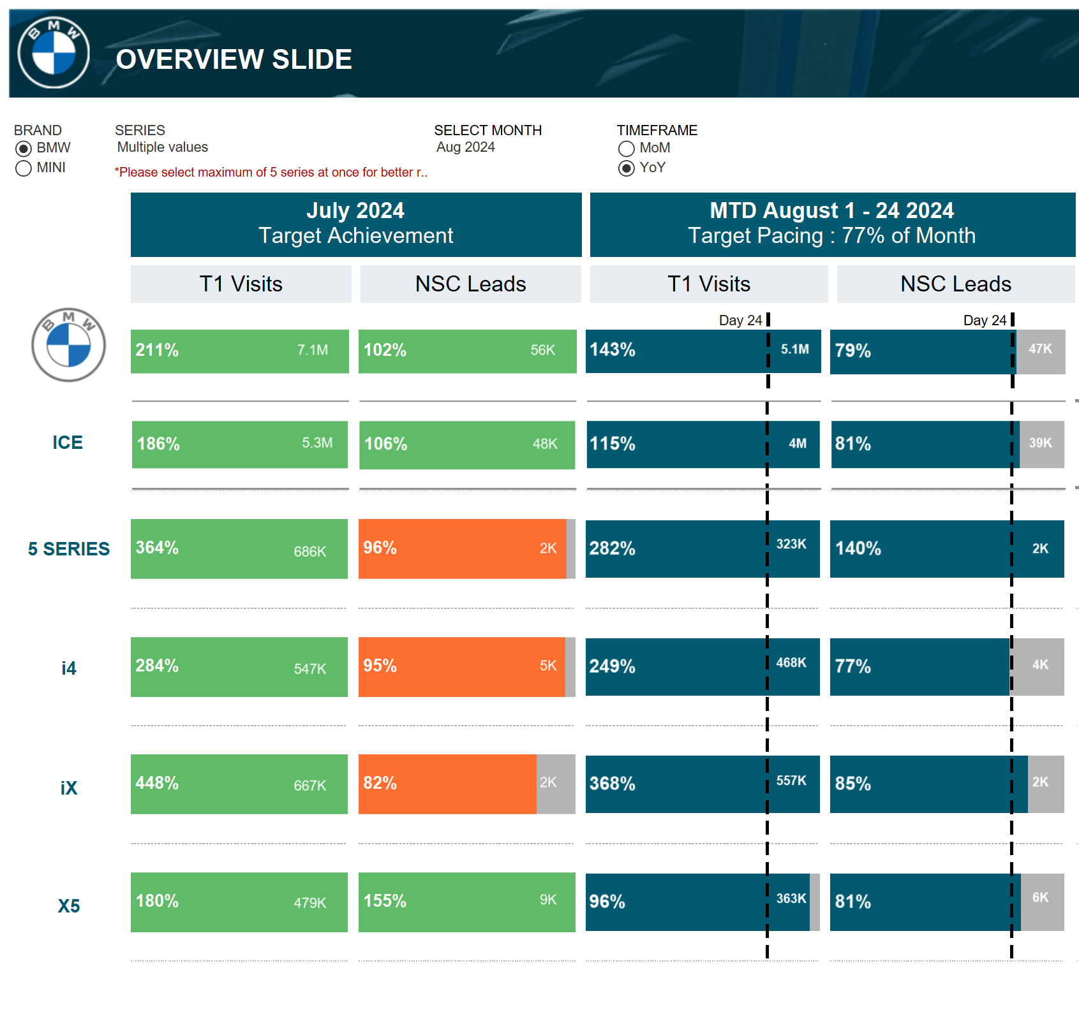
Through august 24th, the 5 series, IX AND X5 ARE outpacing nsc lead targets while the i4 LEADS ARE AT TARGET PACING.
i4 NSC LEAD PACING
77%
1,020 BMWUSA LEADS
iX NSC LEAD PACING
85%
665 BMWUSA LEADS
5S NSC LEAD PACING
140%
421 BMWUSA LEADS
X5 NSC LEAD PACING
81%
2,024 BMWUSA LEADS
Note: BMWUSA SSE Model Share of NSC Lead Targets trended in 2024 in appendix slide 19.
Date Range: January 2024 – August 2024
2024 SSE Campaign | Bi-Weekly Report #4
Notes:
BMWUSA Historical Share of Leads by Model
i4: 42%
iX: 35%
5 Series: 21%
X5: 32%

Slide 5
PERFORMANCE INSIGHTS AND ACTIONS (8/12 -8/25)
GOAL | DRIVE AWARENESS | INCREASE PRIMARY VEHICLE INTEREST | ENCOURAGE LOW FUNNEL ACTIONS | BMW HALO EFFECT
Key Stats
Key Insights | OLV seeing consistent VCR performance after several report-over-report improvements. Amazon remarketing is driving an increased volume of clicks. | Email re-deployments drove increases in IWV and leads. Update to the iX lease offer driving higher report-over-report lift in total leads. | Paid Social retargeting and OMNI audiences are driving efficient leads. T2 Paid Search saw improvement in KBA efficiency and volume. | BYO starts, completes, and leads continue to see lifts site-wide. Total Site Leads increased (7.4%) report-over-report, driven by Paid and Natural Search, with entry to SSE LP driving the largest growth.
Key Actions | Continuing to use OLV/CTV to further drive awareness. Finalize Awareness video testing results on Meta at the end of the campaign. | Shifted budget towards iX and i4 due to stop sale. Monitor performance of new Advantage+ Shopping Campaigns on Meta. Finalize Meta offer testing results at the end of the campaign. | Continue driving conversions using remarketing/retargeting audiences. Monitor T2 PMAX optimization shift towards more valuable conversions. | Monitoring impact on halo as retargeting and remarketing tactic budgets increase.
+10%
Retargeting Audience vs. Prev Report
-3%
OLV View Through Rate
vs. Prev Report
+0.5%
Search Volume vs. Pre-Campaign
-3.2%
Interacting Web Visits vs. Prev. Report
+62%
KBAS (BYO Start + Complete, Inv. Search & Leads vs Prev. Report)
+61%
Campaign Lead Submissions vs. Prev. Report
+3.8%
Leads vs. Pre-Campaign
+10%
BYO Starts vs. Pre-Campaign
+9%
Lease offer update
SSE
Average Daily Lead Increase
+45%
2024 SSE Campaign | Bi-Weekly Report #4
Notes:
BM: SSE 23

Slide 6
sse continues to INCREASE BYO ENGAGEMENT AND LEAD SUBMISSIONS VS PRE-CAMPAIGN, WHILE INVENTORY SEARCH trails pre-campaign volume.
+10% vs Pre-Campaign Average
-10% vs Pre-Campaign Average
+12% vs Pre-Campaign Average
+4% vs Pre-Campaign Average
Source: SSE Actions segmented by - [v] Campaign Tracking | 2024 | Summer Sales Event '24 - All Traffic [Official] Other Traffic: “All Visits” – subtracting SSE visits, Pre-Campaign Date Range: Weekly, April 1, 2024 – August 24, 2024, SSE Campaign Date Range: July 7 – July 27, 2024

Slide 7
T2 updates to pmax have resulted in decreased traffic, but improved kba performance as the optimization learning continues.
BMWUSA SSE Campaign Site Performance Trends 7/2-8/25
Visits by Tier
 | National Visits | T2 Visits
SSE ‘24 | 639K | 1.7M
SSE ‘23 | 771K | 1.1M
YoY % Change | -17% | +56%
Interacting Web Visits by Tier
 | National IWV | T2 IWV
SSE ‘24 | 511K | 1.3M
SSE ‘23 | 725K | 635K
YoY % Change | -29% | +100%
Leads by Tier
 | National Leads | T2 Leads
SSE ‘24 | 2,255 | 714
SSE ‘23 | 3,974 | 2,979
YoY % Change | -43% | -76%
Notes:
[1] Data in graphs is representative of daily trends during the month of July.
[2] Non-paid traffic leads that enter via the campaign landing page are not classified under any tier, leading to a discrepancy between tiered leads and overall campaign leads.
2024 SSE Campaign | Bi-Weekly Report #3
Notes:
Tier
Spend
National (T1 + NT2)
$1,498,218
Regional (T2)
$318,029

Slide 8
The $699 ix lease offer update has boosted lead performance in august.
Similar to SSE and YEE ‘23, the update to the iX Lease Offer has lifted Lead performance from both rate and volume.
iX AVERAGE DAILY LEAD INCREASE
+45%
30 vs. 21 Average Daily Leads Pre vs. Post Offer Update
iX AVERAGE DAILY LEAD RATE INCREASE
+62%
0.16% vs. 0.1% Average Daily Lead Rate Pre vs. Post Offer Update
2024 SSE Campaign | Bi-Weekly Report #3
Notes:
Lead Rate improvement boosted by T2 Search seeing slight improvement across the site.

Slide 9
The $699 ix lease offer update has boosted lead performance in august.
Similar to SSE and YEE ‘23, the update to the iX Lease Offer has lifted Lead performance from both rate and volume.
iX AVERAGE WEEKLY LEAD INCREASE
+5%
iX AVERAGE WEEKLY LEAD RATE INCREASE
+18%
Week of August 18 Lead Rate growth driven by increases from Paid Search, with T2 PMAX improving.
2024 SSE Campaign | Bi-Weekly Report #3
Notes:
Lead Rate improvement boosted by T2 Search seeing slight improvement across the site.

Slide 10
Paid media LEARNINGS, INVESTIGATIONS + OPTIMIZATIONS.
What’s working → Keep doing
Where to improve → Optimize / investigate
What’s not working → Stop doing / reconsider
[VIDEO] Increase in OLV and Streaming efficiency driving larger retargeting pool for Amazon Remarketing | [SOCIAL] OMNI audiences outperforming In-Platform and Retargeting audiences in terms of CPL. | [SEARCH] T2 Standard Search seeing improved CPLs, PMAX optimizations leading to higher action rates and lower CPL.
NEXT STEPS | NEXT STEPS | NEXT STEPS
Applying learnings from SSE to future campaigns: Utilizing new data pools gathered from YouTube & OLV campaigns to remarket users for future campaigns. Continuing YouTube In-Feed ad activations to capture user attention as they search across YouTube. | Monitoring Advantage+ Shopping (conversion) Campaigns that launched last week on Meta to support iX an i4. Shift ~30% of remaining budget from awareness to i4, iX, X3, consideration for a final push towards site traffic. Continue monitoring statistical significance of offer and video (product focused vs lifestyle) testing results for next report. | Capitalizing on learnings from SSE: Analyzing sitelink deployment for possible future use. Analyzing SSE traffic Brand Core campaigns for future incrementals. Beginning the next stage of BMW T2 PMAX optimizations: Adding weighted values to KBAs to prioritize higher value conversions (when applicable). Adding earned retargeting & remarketing lists as signals as a test.
OLV: VCR
-3% vs. previous report
+9%
49%
Top Performing Shows (Amazon)
The Boys, Psych, House
2024 SSE Campaign | Bi-Weekly Report #3

Slide 11

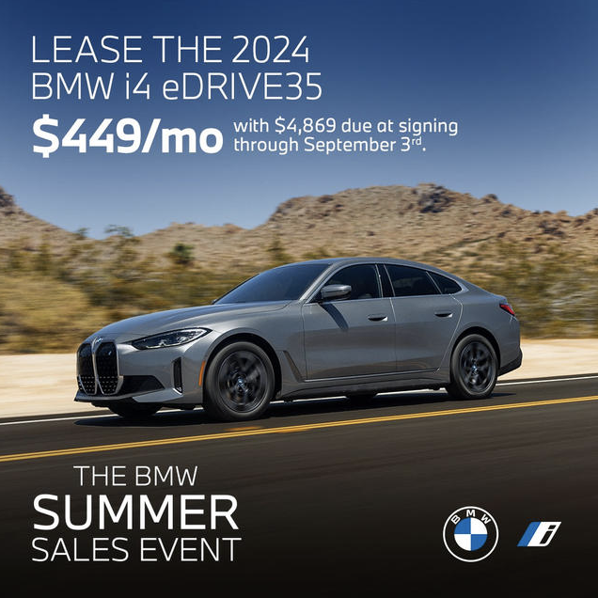
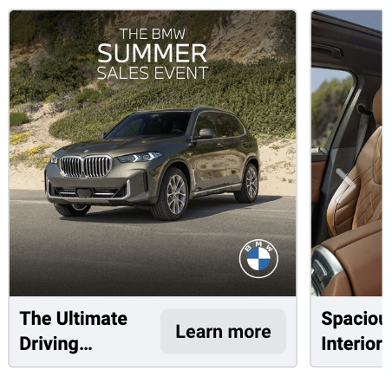
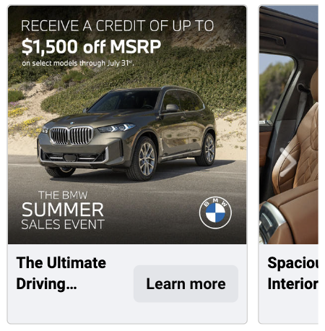
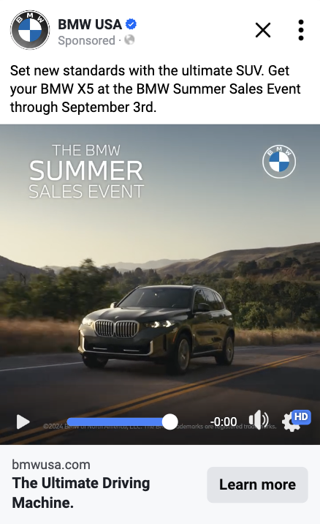
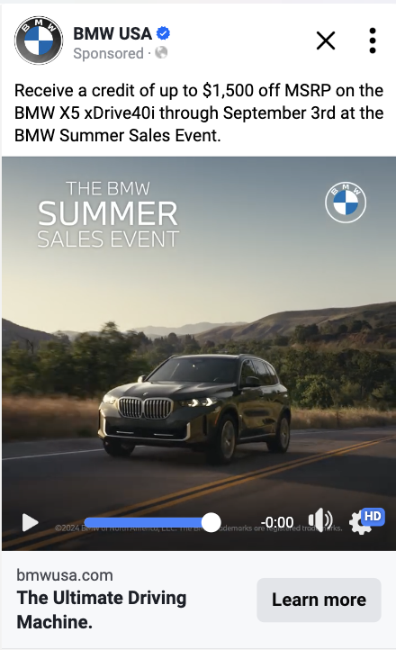
CONSIDERATION: OFFER VS NON-OFFER TEST RESULTS.
 | Variant A: Non-Offer | Variant B: Offer
Static Observational
Carousel A/B Test
Video A/B Test
Preliminary results as test has not concluded
Objective: Determine if adding the sales event offer to the creative in Meta Consideration tactic increases ad engagements and clicks to site.
Observations:
Static (i4): Non-Offer outperformed Offer. However, creative is still ramping up given the low spend volume. Keep running the test and validate the learnings via a structured A/B test.
Carousels (X5): Offer creative outperformed Non-offer with stat sig.
Video (X5): no winner identified yet. The SSE offer not being included in the creative likely impacted the performance.
Next Steps: Keep running the test in static and video. In Carousel, optimizing towards the winning Offer creative.
Winner
Primary KPIs
Static (i4) | Spend | CTR | CPC | IWV | IWV Rate | CP IWV | KBAs | ACR | CPA
Non-Offer | $658 | 0.80% | $1.5 | 285 | 0.53% | $2.3 | 36 | 0.07% | $18.3
Offer | $586 | 0.54% | $1.4 | 275 | 0.36% | $2.1 | 33 | 0.04% | $17.8
Carousel (X5) | Spend | CTR | CPC | IWV | IWV Rate | CP IWV | KBAs | ACR | CPA
Non-Offer | $4,520 | 0.39% | $1.4 | 1,538 | 0.19% | $2.9 | 253 | 0.03% | $17.9
Offer | $4,805 | 0.45% | $1.4 | 1,911 | 0.25% | $2.5 | 331 | 0.04% | $14.5
*IWV Rate = IWVs/Impressions; ACR = KBAs/Impressions
Notes:
Consideration avg. CTR: 1.11%, IWV rate: 0.47%

Slide 12
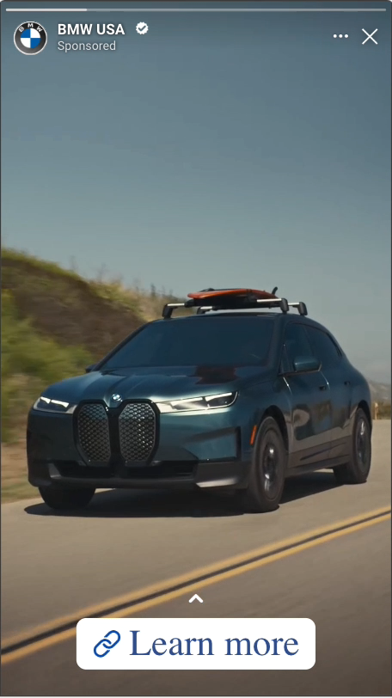
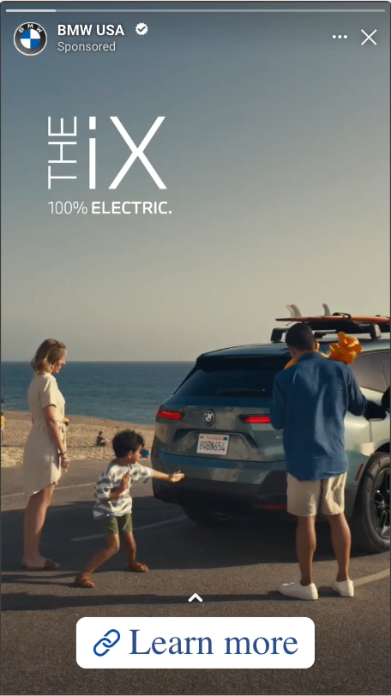
AWARENESS: INITIAL VIDEO IMAGE TEST RESULTS.
Preliminary results as test has not concluded
Objective: Determine from a sales event standpoint, if leading with an image of a vehicle or person(s) is a more engaging hook for a paid social ad.
Observations:
Platform algorithm geared towards the Vehicle Centric version, which delivered more Ad Recall Lift and Reach vs. Lifestyle Centric.
From an engagement perspective, the two versions had similar performance, with Vehicle Centric version seeing slightly higher CTR.
Next Steps: Keep running the test until campaign ends. Store learnings in learning library and consider additional testing for further validation.
Observational
Variant A: Vehicle Centric | Variant B: Lifestyle Centric
Primary KPI
Version | Spend | Reach | Ad Recall Lift* | CTR | CPC
Vehicle Centric | $125,220 | 11,155,092 | 289,860 | 0.11% | $2.72
Lifestyle Centric | $18,807 | 3,799,479 | 123,300 | 0.10% | $2.96
*Est Ad Recall Lift: An estimate of the number of additional people who may remember seeing your ads (within 2 days). This metric is only available for assets in the awareness and engagement objectives.

Slide 13
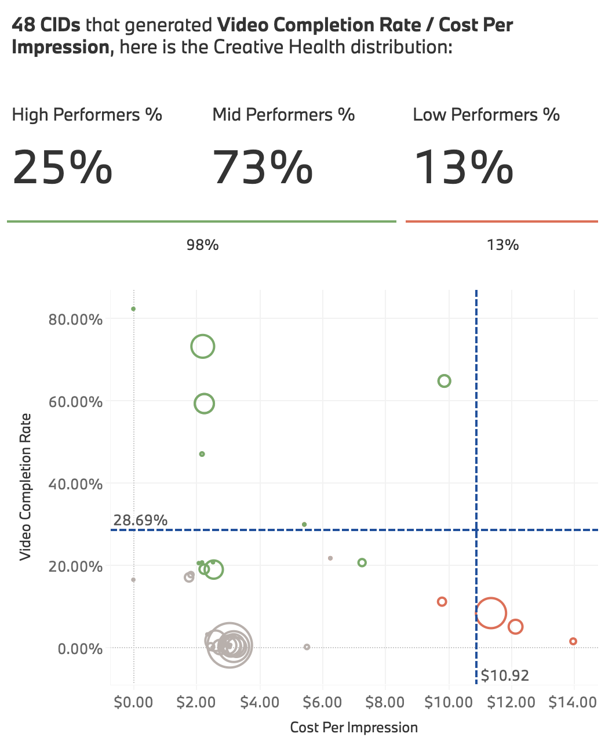
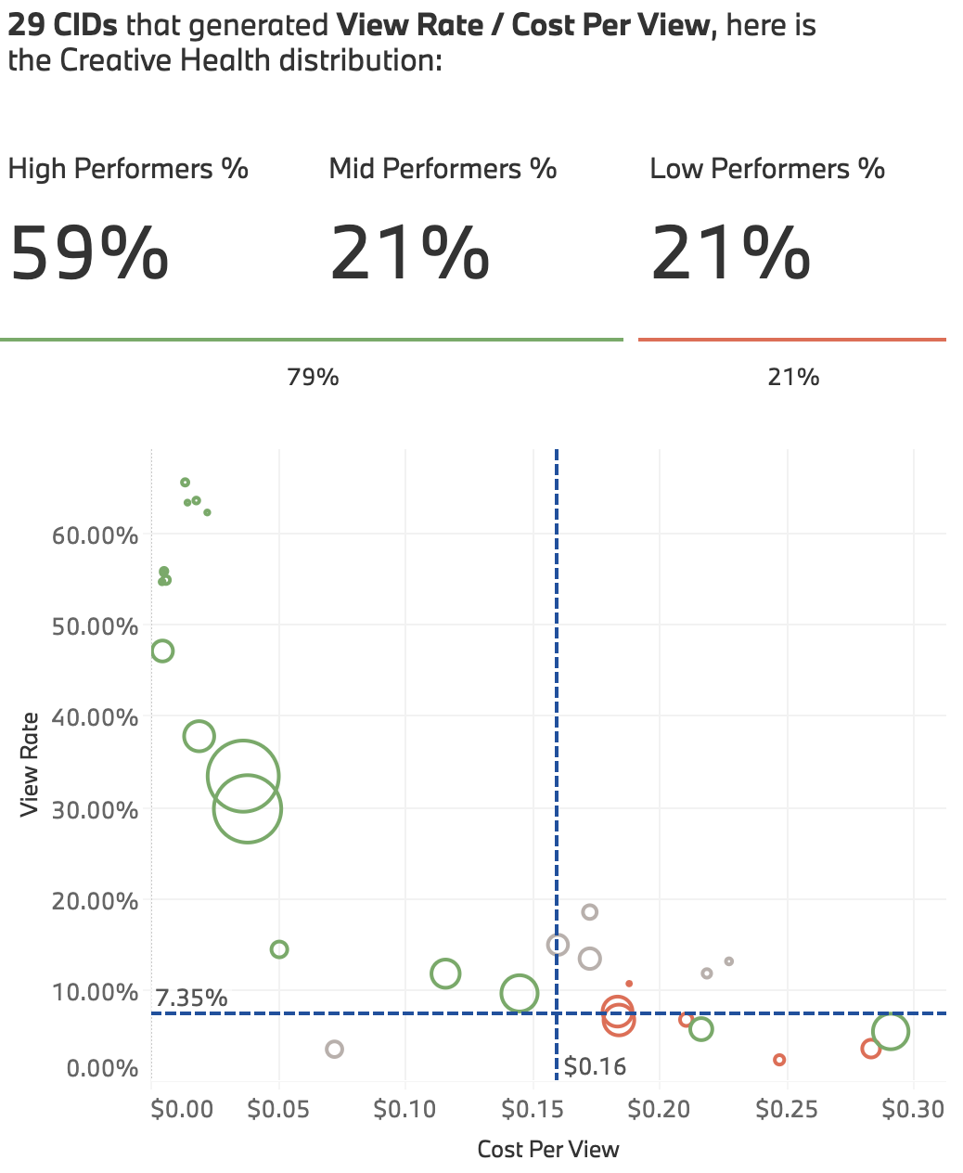
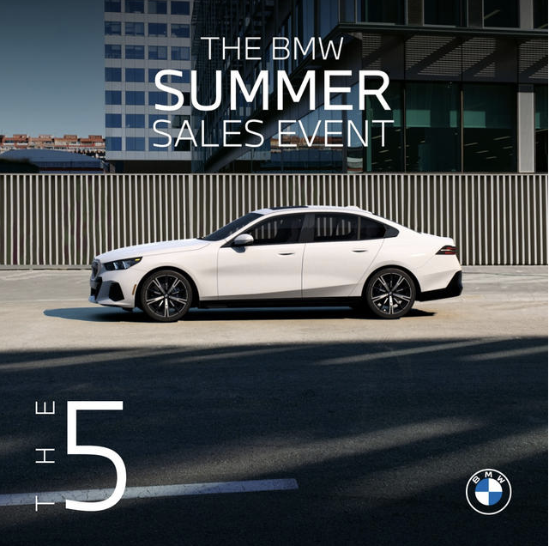
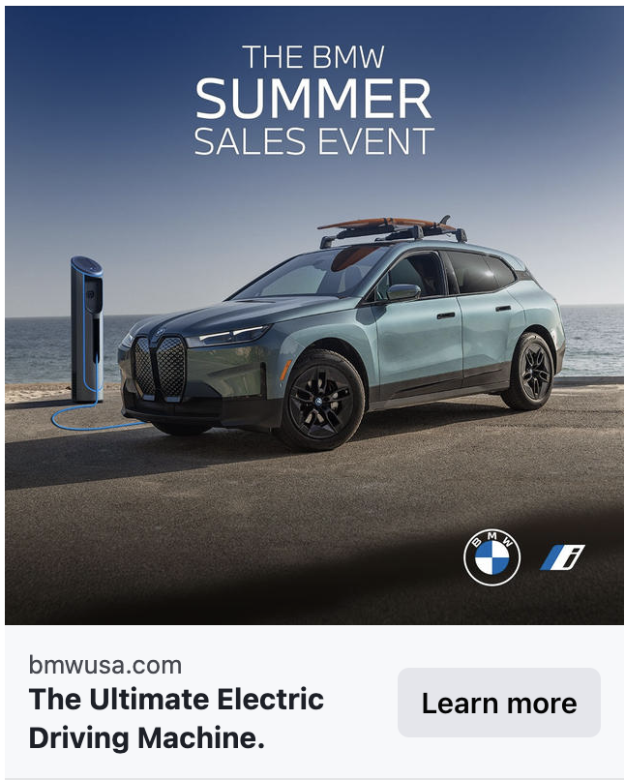
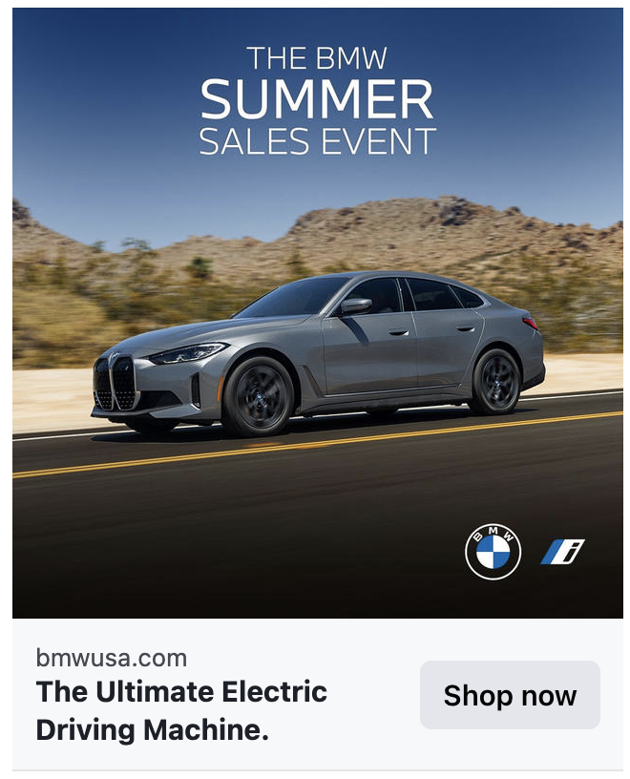
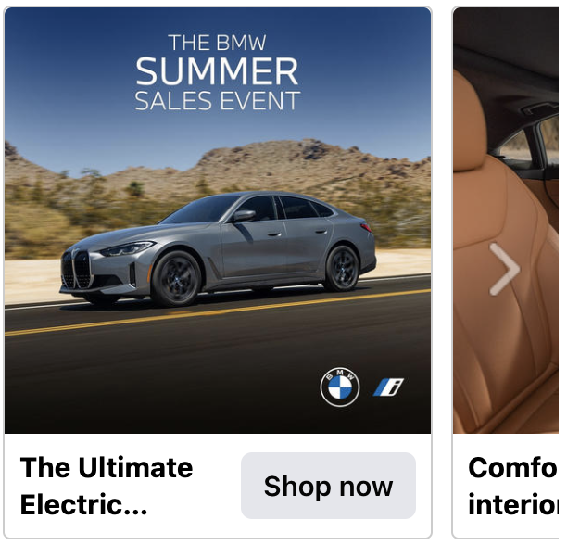
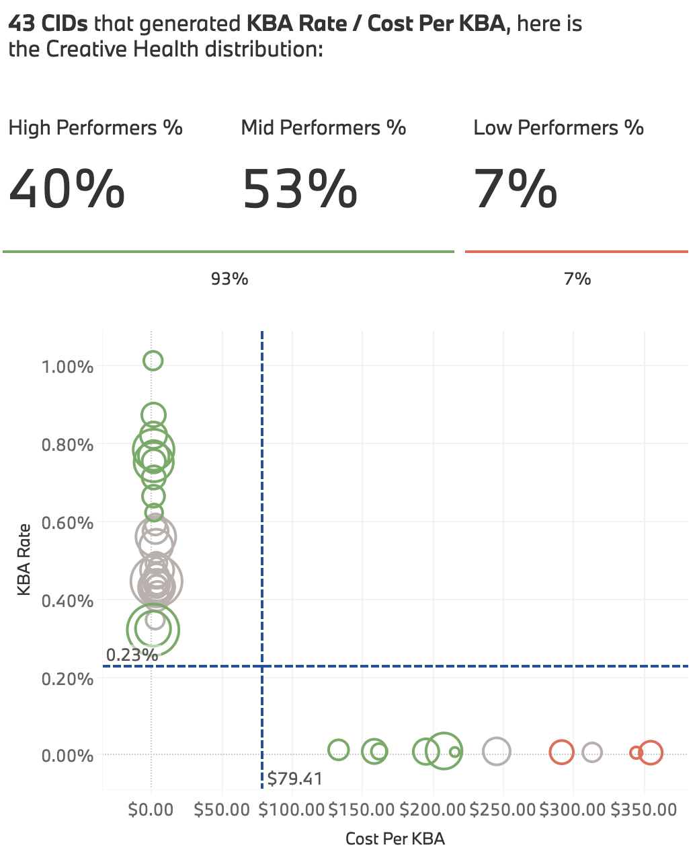
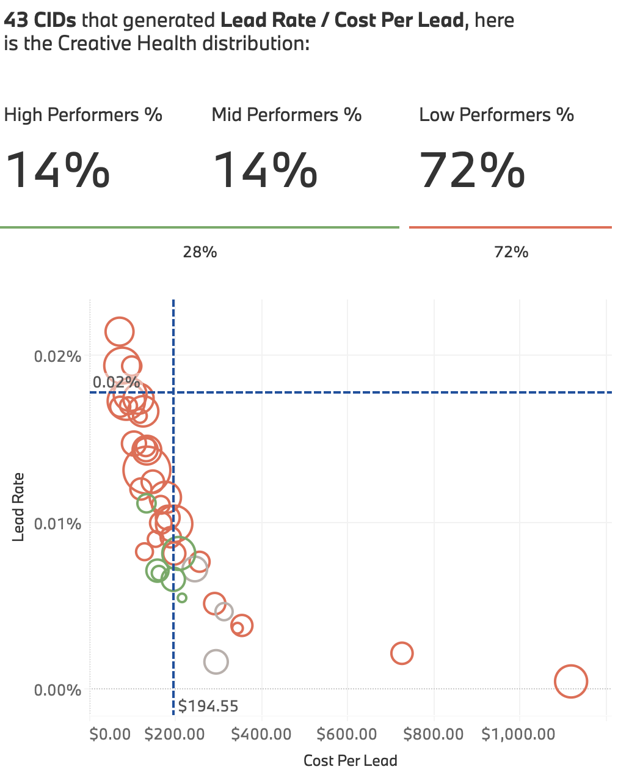

Improvement seen across funnels especially in conversion objective creative
AWARENESS
Consideration
What’s working → Keep doing
Creative Elements:
CONS + CVR | Ad Format: Video excelled at engaging users and driving traffic while static delivered more KBAs.
CONS - Static | CTA Copy: Shop Now drove higher CTR but Learn More performed well in KBAs
CVR - BYOA | Vehicle Angle + BG: profile shot paired with urban scenery outperformed front shot paired with landscape scenery.
CVR – BYOA | Vehicle Type: ICE creative outperformed BEV creative with higher KBA rate.
What’s not working → Consider optimizing/ testing
Creative Elements:
AWR | Video Length: 30s underperformed 6s and 15s in terms of engagement rate.
CONS + CVR | Ad Format: Carousel assets had the lowest engagement rate across funnels
CONS – Video | Copy: Showing SSE offers in the post copy had low impact on creative performance.
CVR - BYOA | Background Contrast: Retargeting creative that had cars with a similar color as the background saw lower KBA rate than cars with higher background contrast.
Conversion
leads
+9% pts
-10% pts
*CID Circle color coding is accurate while benchmark lines default to one platform however color coding is based on unique platform benchmarks.
2024 SSE Campaign | Bi-Weekly Report #4

Slide 14


2024 TO-DATE: CRM TOUCHES TO DATE OVER 6 WEEKS
New creatives
Repeat deployment of creatives
July 12
July 18
July 25
August 6
August 20
August 27
CONQUEST, WINBACK
All 4 Vehicles, emphasis on EV
VERSION A
July 12
July 19
August 2
August 28
ICE + EV versioning
HANDRAISERS
VERSION B
July 12
July 19
August 2
August 28
ICE + EV versioning
CURRENT OWNERS/LESSEES
VERSION C
Data through Aug 22

Slide 15
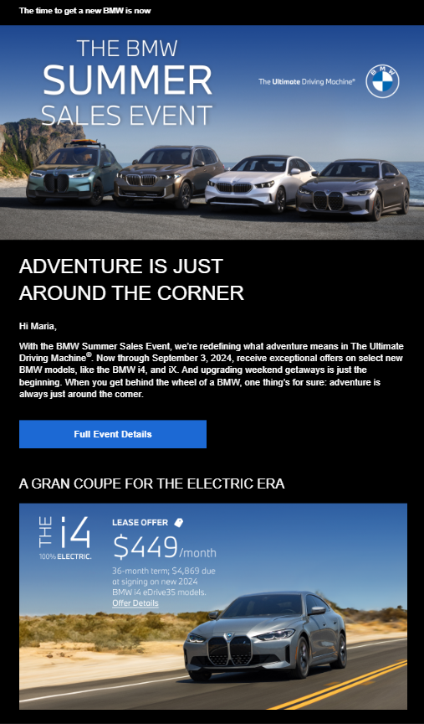
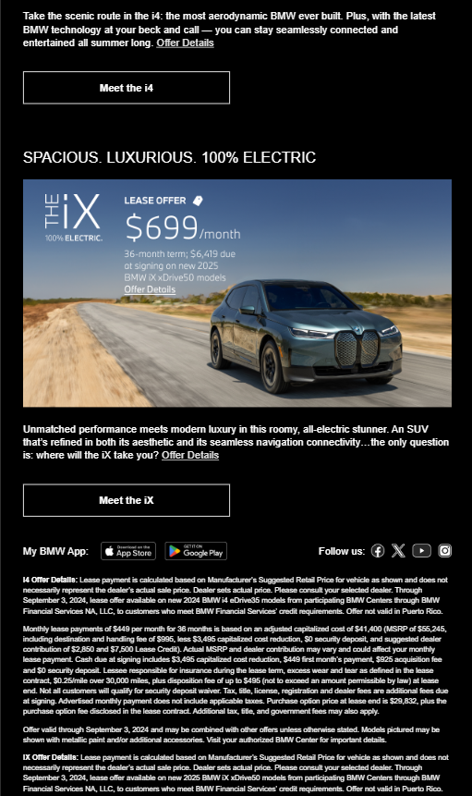
STRONG PERFORMANCE FROM EM4 COMMS GENERATING MORE INTEREST AND SITE TRAFFIC
EM4 Performance
Winback EM4 is performing exceptionally well when compared to the YTD ‘24 SSE Aggregate
EM4 CTR
+1.4x
Higher ‘24 SSE Agg
(0.89% vs 0.63%)
EM4 Unsub Rate
-8x
Lower ‘24 SSE Agg
(0.02% vs 0.16%)
EM4 Leads
11.1k
2nd Highest per EV touchpoint
EV Growth
EV sees higher CTR across all audiences, especially amongst In-market and Lead audience segments
EV aggregate
3x
Higher CTR YoY
(0.69% vs 0.23%)
In-market
21x
Higher CTR YoY
(0.63% vs 0.03%)
Lead
4x
Higher CTR YoY
(1.13% vs 0.28%)
2024 SSE Campaign | Bi-Weekly Report #4

Slide 16
SSE CAMPAIGN SUMMARY AND Next steps
SSE remains effective at driving awareness: continue with awareness efforts.
Lead rates for campaign models have increased: focus on email deployments and lease offers to drive leads.
Paid Search leads are seeing improvement but are down year-over-year: reviewing T2 PMAX strategy.
Leads site-wide continue to increase report-over-report: continue halo effect analysis.
WE ARE HERE
8/25
 | Aug 1 – Aug 4 | Aug 5 – Aug 11 | Aug 12 – Aug 18 | Aug 19 – Aug 25 | Aug 26 – Sept 3
Paid Social
Paid Search
Direct Partnerships
Media (General)
CRM
Organic Social
T1: Increased support against iX in consideration (decreased i4)
T1: Heavy-up in Conversion with new A+ shopping campaigns (i4, iX)
T1: Paid social support switched to i4 and iX only (Stop Sale)
T1+T2 paid social launched X3 creative. Rotation updated to i4, iX, X3
T1: TikTok creator content launched in paid
T1 Budget shift from Awareness to consideration.
T2: Optimizing PMAX by shifting to improved conversion goals to drive higher lead volume (8/1)
Review T2 PMAX Optimizations > Adding Conversion Values
T1 + T2: Sitelink expansion to increase SSE awareness (8/1)
T1 + T2 Sitelinks: Review existing deployment & possible expansion.
T1: Brand Core SSE Ads (Confirmed & Deployed)
T1: Shifted Amazon weight to spend more against display placements
Creative swap 8/1
Stop Sale Changes: Across T1 and T2 (slide 10)
EM3 planned deployment on 8/6 (Prospects & Owners)
CTA Copy Test in progress across EM1, EM2, EM3
Winback & Conquest: EM5 planned deployment on 8/20
Winback & Conquest: EM6 planned deployment on 8/27
Prospects & Owners: EM4 planned deployment on 8/28
Organic social: posted IX carousel on 8/14
Organic social: posted X5 carousel on 8/21
2024 SSE Campaign | Bi-Weekly Report #4
Notes:
NEW UPDATES:
Creative rotation change in social: i4, ix, X3 + X3 social launch.

Slide 17
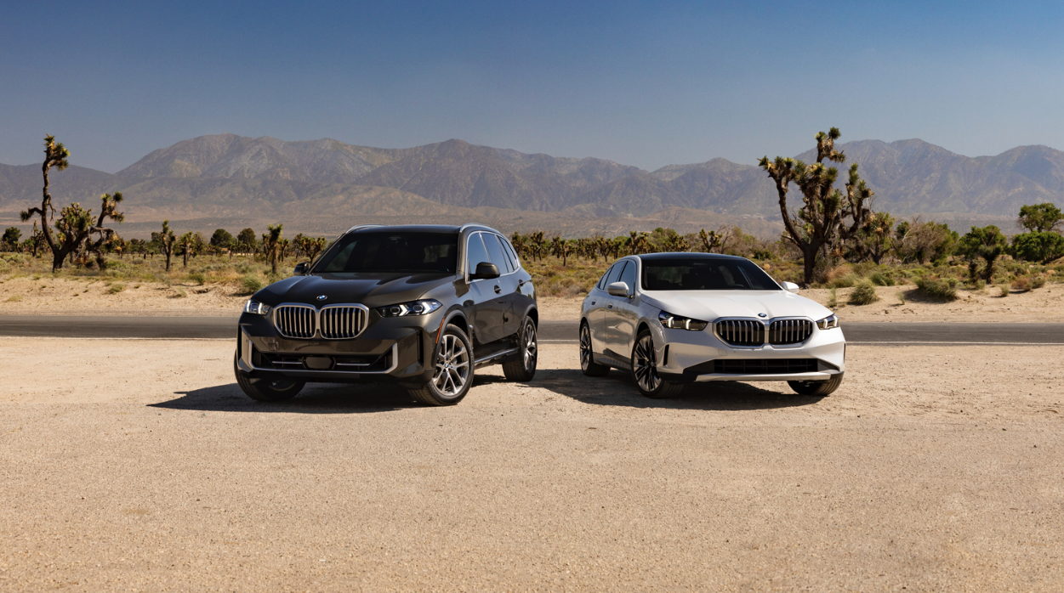

APPENDIX.
17
Notes:
Sam/zach

Slide 18
BMW USA.
KPI GLOSSARY.
Media KPI Definitions:
Budget Pacing = Spend to date / Total estimated spend
VCR (Video Completion Rate %) = Videos Play at 100% / Impressions
CPV (Cost per Video Completion) = Spend/ Videos Play at 100%
CTR (Click Through Rate %) = Clicks / Impressions
CPC (Cost Per Click $) = Spend / Clicks
ACR (Action Rate %) = Actions (from platforms) / Impressions
CPA (Cost Per Action $) = Spend / Actions (from platforms)
Site KPI Definitions:
IWV: Interacting Web Visit
IWVR: Interacting Web Visit Rate
IWVR = IWV / Visits
BYO Start Rate = BYO Starts / IWV
BYO Completion Rate = BYO Completes / BYO Starts
Inventory Search Rate = Inventory Search / IWV
Lead Submission Rate = Leads / IWV
Campaign Segment Logic:
Traffic entering the campaign landing page
Traffic entering campaign vehicle PDPs from paid sources, which contain the tracking parameter “sse24” or through Paid Search.
Traffic entering campaign vehicle PDPs from organic sources.
Data Sources and Benchmarks
Source: Adobe Analytics, Platform Data, CRM Data
Benchmarks: Projections from Media Partners
Month Ahead Lead Projections: Tableau
2024 SSE Campaign | Bi-Weekly Report #3

Slide 19
MEDIA SUPPORT FOR SSE LAUNCHED ON 7/2 ACROSS TIERS AND MEDIA CHANNELS.
We're here
JUL 2
AUG 11
SEPT 3
SUMMER SALES EVENT CAMPAIGN PARAMETERS
Full Campaign Budget | NATIONAL ($9,208,692) T2 ($28,247,081) *T2 budget includes all July-August Core and EV Spend Total ($37,455,774)
Business Objective | Drive towards SSE lead and sales targets
Media Objective | Drive awareness and consideration for SSE with new segmented Omni audience approach to move audiences down the funnel and deliver against performance goals
Media KPI and Projections | KBAs + Leads (+ Remarketable Reach to fuel lower funnel)
Media Audiences | 1PD Look-Alike, Omni (Owner Conquesting, Upgraders, In-Market, In-Market Conquesting) Remarketing + Site Retargeting BYOA (Social Only)
Model Support | Awareness (60% EV [36% i4, 24% iX], 40% ICE) Consideration (40% i4, 15% iX, 30% 5S, 15% X5)
Paid Channels | Linear, CTV, OLV, OOH, Audio, Display, Social, Search
Landing Page | SSE Landing Page, PDPs (all 4 models), BYO Studio
2024 SSE Campaign | Bi-Weekly Report #3
Page 19

Slide 20
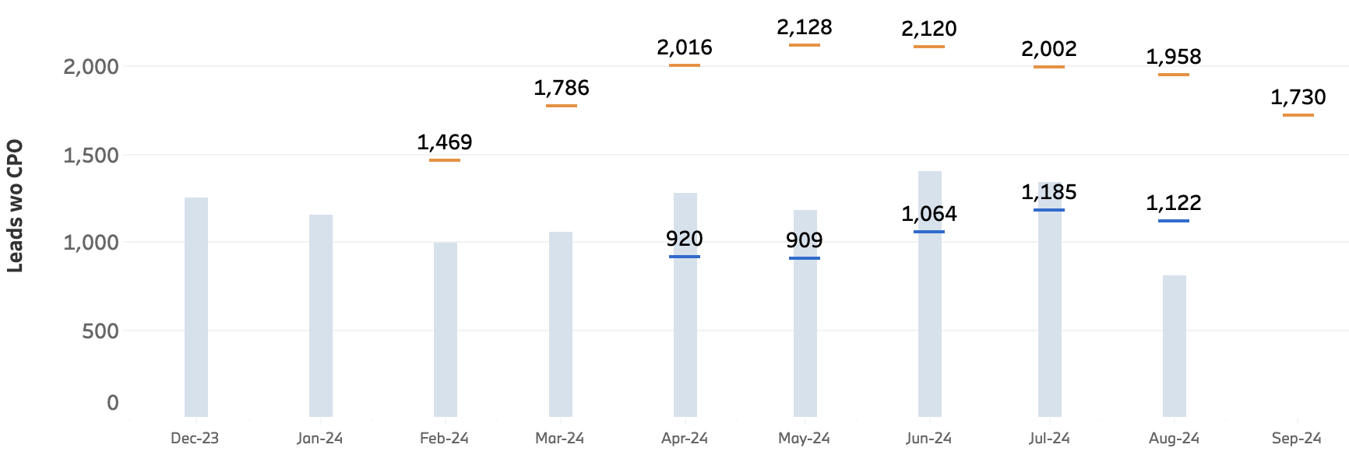
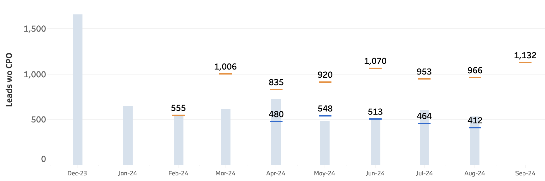
lead target pacing: BOOSTED BY THE UPDATED LEASE OFFER, THE iX LEADS ARE PACING TOWARDS RTF TARGETS, WHILE THE i4 WILL NOT REACH TARGET.
MONTHLY PACING (8/1 – 8/31):
81% of AUGUST ’24
i4 Total Leads
iX Total Leads
1,082
706
Legend:
- August RTF Target
- August Campaign Projection
▮ Month-to-date Actuals
i4 Leads in August: 1,082
96% of August Projection
55% of August RTF Target
iX Leads in August: 706
172% of August Projection
73% of August RTF Target
Note: Month Ahead Lead Projections and RTF Targets are for the full month of August. Pacing percentage reflects how far we are into the month.. Date Range: August 1 – August 11, 2024. Source: Adobe Analytics.
Workspace: [w] Summer Sales Event '24 Campaign Tracking [WIP]. Traffic Segments: [h] 5 Series Interaction [Official], [h] X5 Interaction [Official], [h] iX Interaction [Official], [h] i4 Interaction [Official]. See Appendix for KPI and metric definitions.
2024 SSE Campaign | Bi-Weekly Report #3
Notes:
Projections are from the month ahead lead projections dashboard and are not campaign specific.
i4 Leads: Slight MoM decrease in Leads, with Natural Search and Direct driving decreased Lead Rates, with Homepage entry seeing increased i4 Leads but at a lower rate. Incremental budget for i4 in June.
iX Leads: MoM increase in Leads driven by Paid Search, Paid Social and Direct Entry. Much of the T2 Traffic for SSE is driving to the iX PDP, where Lead Rate is very low. Working with media team to improve conversion going forward.

Slide 21
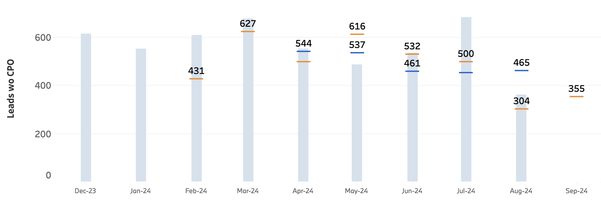
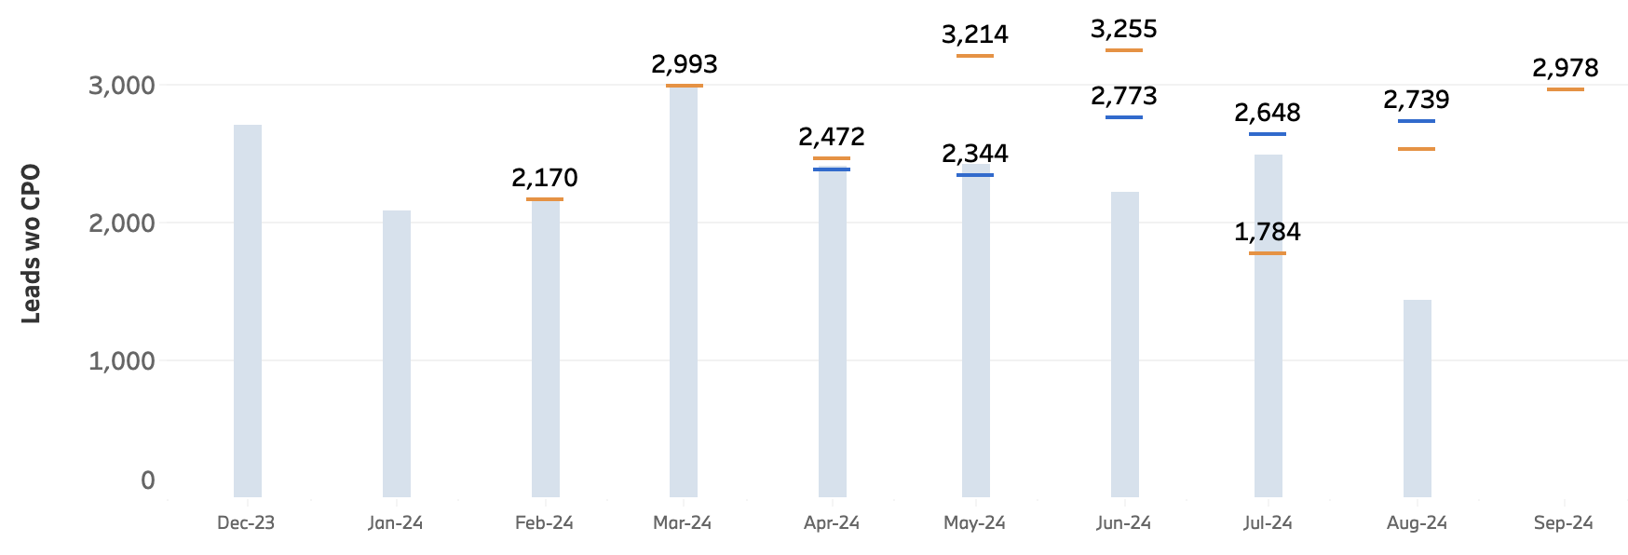
lead target pacing: BOTH THE 5S & X5 ARE PACING WITH OR AHEAD OF RTF TARGETS.
MONTHLY PACING (8/1 – 8/31):
81% of AUGUST ’24
X5 Total Leads
5 Series Total Leads
429
2,096
Legend:
- August RTF Target
- August Campaign Projection
▮ Month-to-date Actuals
5 Series Leads in August: 429
92% of August Projection
141% of August RTF Target
X5 Leads in August: 813
77% of August Projection
82% of August RTF Target
Note: Month Ahead Lead Projections and RTF Targets are for the full month of August. Pacing percentage reflects how far we are into the month.. Date Range: August 1 – August 11, 2024. Source: Adobe Analytics.
Workspace: [w] Summer Sales Event '24 Campaign Tracking [WIP]. Traffic Segments: [h] 5 Series Interaction [Official], [h] X5 Interaction [Official], [h] iX Interaction [Official], [h] i4 Interaction [Official]. See Appendix for KPI and metric definitions.
2024 SSE Campaign | Bi-Weekly Report #3
Notes:
Projections are from the month ahead lead projections dashboard and are not campaign specific.
5 Series: MoM increase in 5 Series Leads driven by Paid Search and Direct traffic.
X5: MoM increase in Leads for X5 driven by Paid Search, Natural Search and Paid Social, with Homepage, PDP and BYO entry all seeing greater lead volumes MoM.

Slide 22
How do we define success.
GOAL
DRIVE AWARENESS
INCREASE PRIMARY VEHICLE INTEREST
ENCOURAGE LOW FUNNEL ACTIONS
BMW HALO EFFECT
METHOD
Generate interest for the Summer Sales Event and primary campaign vehicles, i4, iX, X5 and 5 Series
Net increase in Interacting Web Visits (IWVs) for featured SSE models compared to pre-campaign IWVs.
Increase in leads for i4, iX, X5 and 5 Series compared to prior to campaign launch
Increase in website leads and on-site actions outside of primary campaign vehicle
PRIMARY KPIs
Increase retargetable audience size
Interactive Web Visits
Leads and buying actions for i4, iX, X5 and 5 Series
Halo leads and interest to the site
SECONDARY KPIs
Increase positive sentiment for the creative and the brand
Ad recall and estimated ad recall lift rate
Increase in organic interest for primary vehicle keywords
Organic Search queries and Organic and Paid SOV for i4, iX, X5 and 5 Series
Net increase compared to baseline in Key Buying Actions for i4, iX, X5 and 5 Series
BYO Starts & BYO Completes
Inventory Searches
Increase in organic interest for BMW keywords
Organic Search queries and Organic Traffic increase for BMW keywords
Baseline: compared to prior to campaign launch and comparison with the 2023 Summer Sales Event
2024 SSE Campaign | Bi-Weekly Report #3
Notes:
BM: SSE 23

Slide 23
In the first month of SSE, the iX, 5 SERIES AND X5 ALL SAW THEIR SHARE OF LEADS FROM T1 INCREASE VS NSC TARGETS.
2024 SSE Campaign | Bi-Weekly Report #3
Notes:
BMWUSA Historical Share of Leads by Model
i4: 42%
iX: 35%
5 Series: 21%
X5: 32%

Slide 24
DETAILED CHANNEL LEARNINGS
What’s working → Keep doing
Where to improve → Optimize / investigate
What’s not working → Stop doing / reconsider
[VIDEO] Increase in OLV and Streaming efficiency driving larger retargeting pool for Amazon Remarketing | [SOCIAL] Retargeting continues to perform strongly, OMNI audiences seeing further performance improvements | [SEARCH] T2 standard search delivers more efficient while T1 PMAX drives higher interaction and greater efficiency
HIGHLIGHT | HIGHLIGHT | HIGHLIGHT
OLV: OLV experienced 3% lower VCR moving into weeks 7 & 8 after experiencing consistent week-over-week gains throughout the campaign. Streaming: Peacock seeing continually improving efficiency with –98% CPV compared to previous report. Amazon Video performed consistently in terms of VCR with previous reports, with The Boys, House, and Psych remaining the top performing shows. Display: Amazon Remarketing ads saw a 5.6% increase in spend compared to the previous report, driving a 9.3% increase in clicks. | Audience: OMNI audiences are outperforming In-Platform audiences across all platforms in both CTR and VCR in all funnel stages (1.33% CTR, 1.18% VCR) We have engaged 62% of our Meta remarketing + retargeting audience size of ~22.5M since campaign launch, a +27% improvement from the previous report. Platform: TikTok continues to see the highest CTR of all platforms (0.3%) except in Consideration, where Meta outperforms. Pinterest is seeing strong VCR performance (19.1%) outperforming both Meta and TikTok. Model: Since stop sale shift towards EVs, iX has seen the highest click-through rate across platforms in Consideration and Conversion funnel stages. | T2: Standard search makes up a larger proportion of spend than PMAX (52% of total) and is delivering more efficient actions and leads. Compared to the previous report, CPL across both standard search and PMAX decreased (-15% standard search, -21% PMAX), indicating improved efficiency. T1: Focused on the i4, T1 PMAX saw over 1.2x more impressions than standard search with lower spend (-13.5%). While driving a significantly lower CTR as a result (7.5%), PMAX ads drove more efficient CPA and CPL (-97% CPA, -181% CPL vs. standard search)
NEXT STEPS | NEXT STEPS | NEXT STEPS
Applying learnings from SSE to future campaigns: Utilizing new data pools gathered from YouTube & OLV campaigns to remarket users for future campaigns. Continuing YouTube In-Feed ad activations to capture user attention as they search across YouTube. | Monitoring Advantage+ Shopping (conversion) Campaigns that launched last week on Meta to support iX an i4. Shift ~30% of remaining budget from awareness to i4, iX, X3, consideration for a final push towards site traffic. Continue monitoring statistical significance of offer and video (product focused vs lifestyle) testing results for next report. | Capitalizing on learnings from SSE: Analyzing sitelink deployment for possible future use. Analyzing SSE traffic Brand Core campaigns for future incrementals. Beginning the next stage of BMW T2 PMAX optimizations: Adding weighted values to KBAs to prioritize higher value conversions (when applicable). Adding earned retargeting & remarketing lists as signals as a test.
2024 SSE Campaign | Bi-Weekly Report #3

Slide 25
DETAILED CHANNEL LEARNINGS
What’s working → Keep doing
Where to improve → Optimize / investigate
What’s not working → Stop doing / reconsider
[AUDIO] Spotify Sponsored Sessions continued to see high CTRs, Mobile Overlay ads seeing efficiency gains
HIGHLIGHT
Spotify: CTR was 2.5% lower compared to the previous reporting period, driven by Sponsored Sessions (2% CTR), while Mobile Overlay ads drove efficient CPM ($14.20) . In-Market audiences outperformed Affinity audiences with higher CTR across all ad types.
NEXT STEPS
Continue running incentive-based ad formats with high engagement to drive awareness and consideration of SSE messaging.
2024 SSE Campaign | Bi-Weekly Report #3

Slide 26
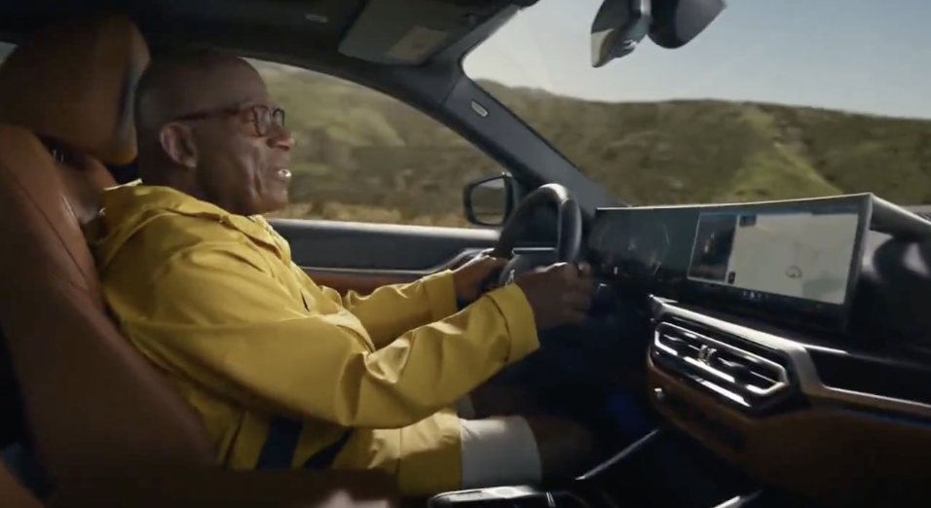
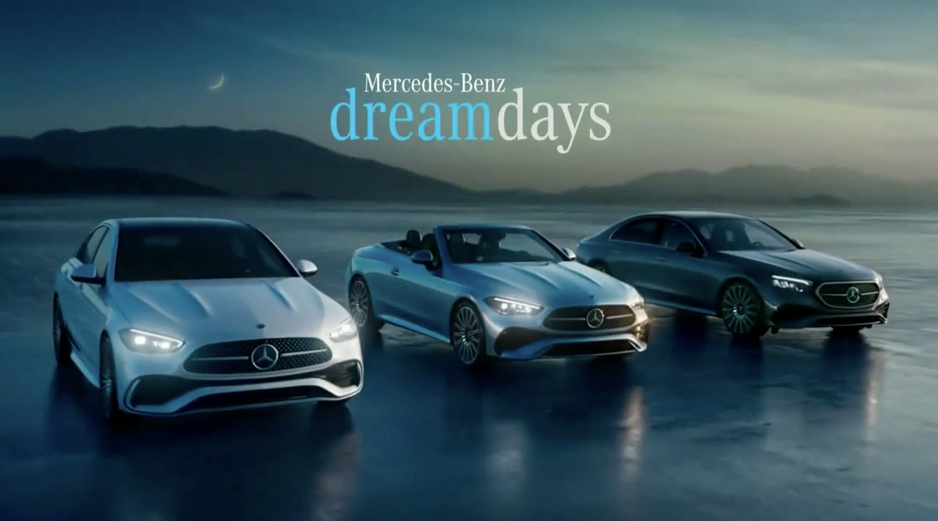
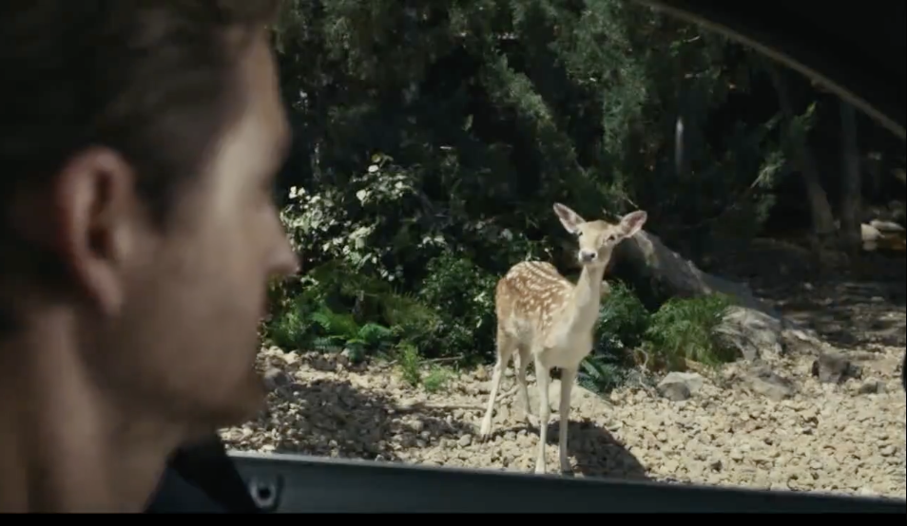
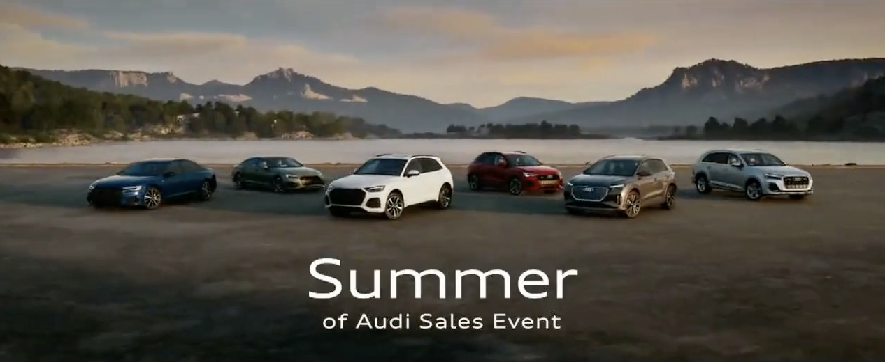

ON PAR TO FAR ABOVE COMPETITORS.*
BMW: Summer Is All Yours
ACE Score: 607
Mercedes Benz: Make Your Dreams Come True
ACE Score: 552
BMW: Best Part of Summer
ACE Score: 551
Audi: Go Your Own Way
ACE Score: 551
Lexus: Golden Opportunity Sales Event (:15)
ACE Score: 530
* Tracked in ACE as of 7/25/24
Page 26

Slide 27
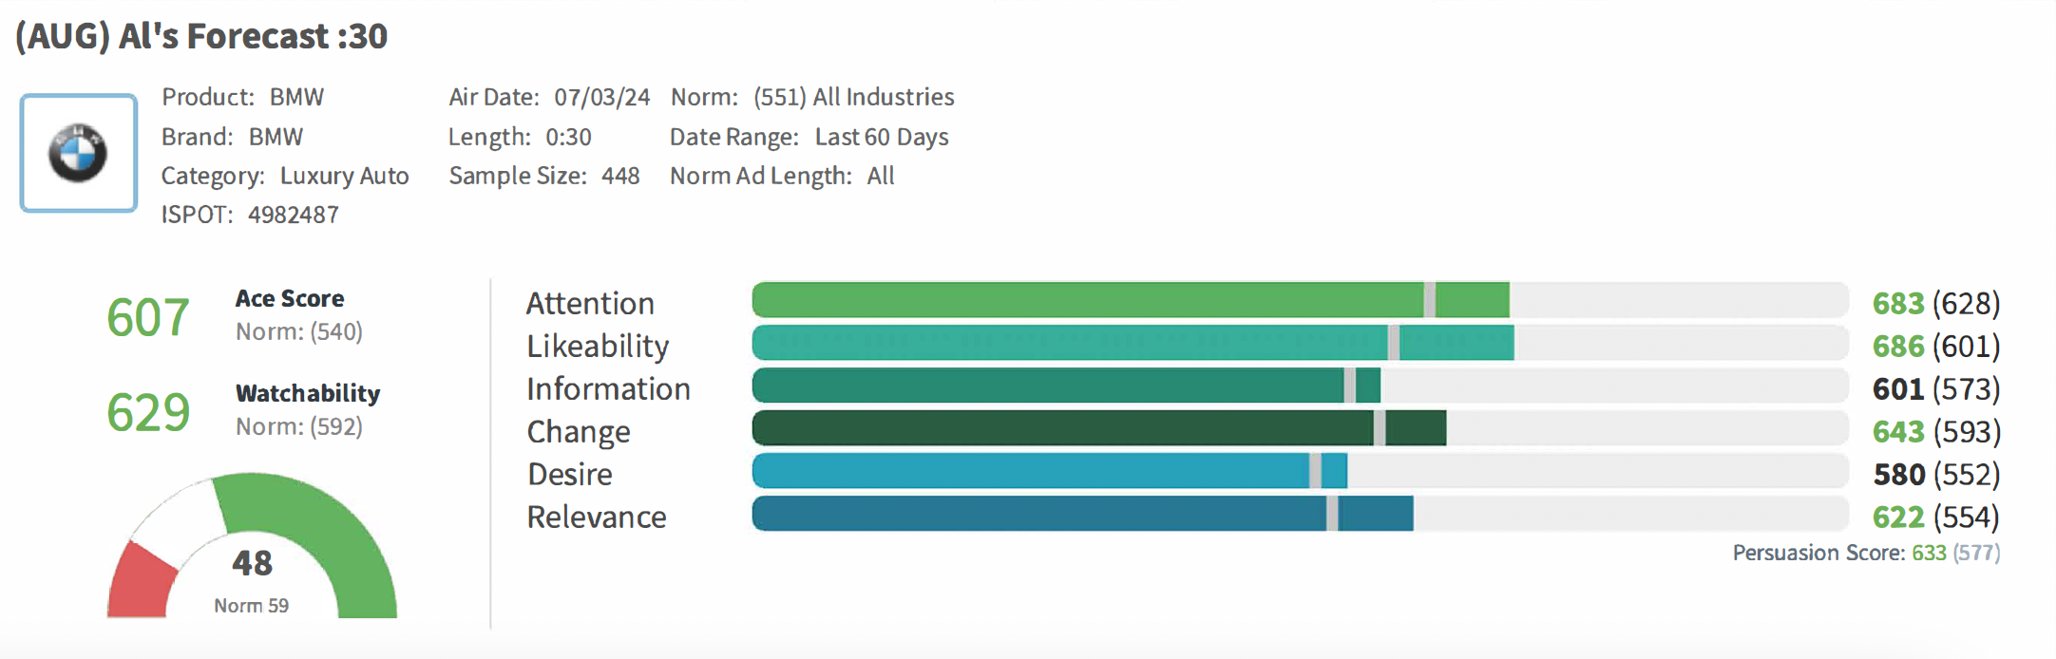
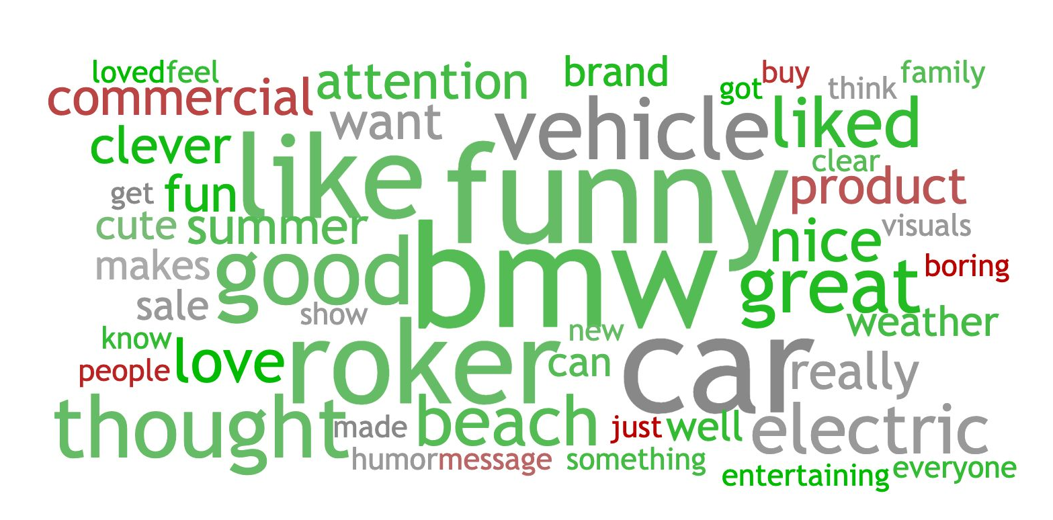
SUMMER IS ALL YOURS JOINED THE 600+ ACE SCORE CLUB – close to all time high of 627 (Last beach chair).
“Liked the ad. Think it is clever using Al Roker as the weather man to get everyone off the beach so he can have it to himself. All this while he is driving an electric BMW to the beach”
“I thought this ad was funny and inspiring. Giving information as well as being entertained with al roker.”
“I like Al Roker and seeing him in the ad For BMW. It caught my attention. I also like the summer sales.”
Page 27

Slide 28
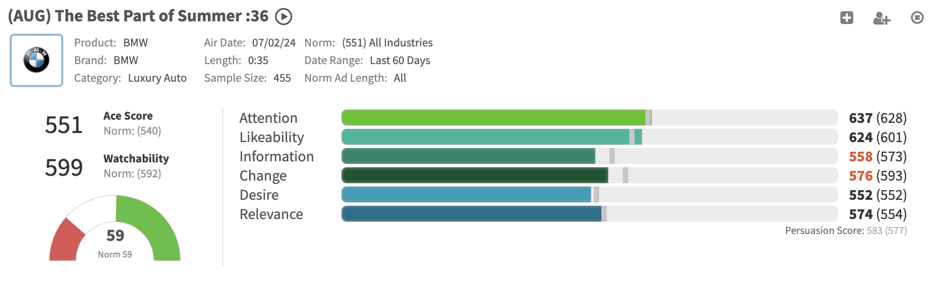
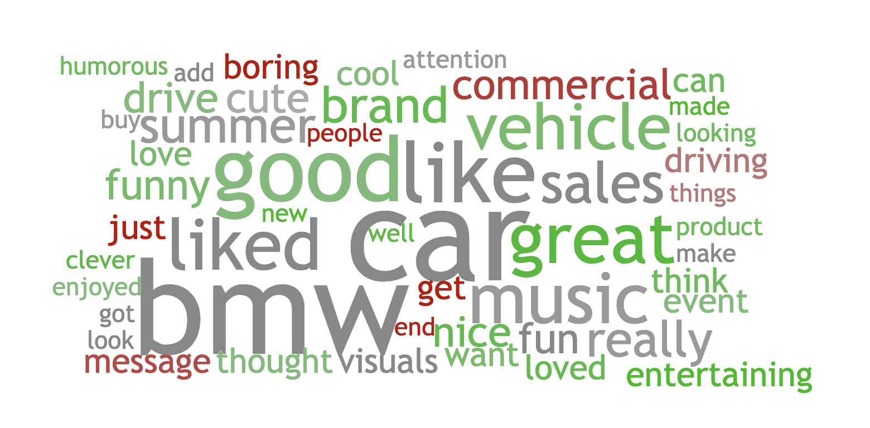
BEST PART OF SUMMER SCORED ABOVE ACE LUXURY AUTO NORM.
“I really liked the ad. I lived the music in the background and the people in each vehicle. It suggests that BMW is on the move - taking you to wherever you want to travel.”
“I thought this was an enjoyable commercial. It was cute the way they made different excuses just to drive the car. It made you feel that it was a car worth driving!”
“I didn't understand the message right away, but it came together at the end. Once I got it, I thought it was a clever way to showcase the product.”
Page 28

Slide 29
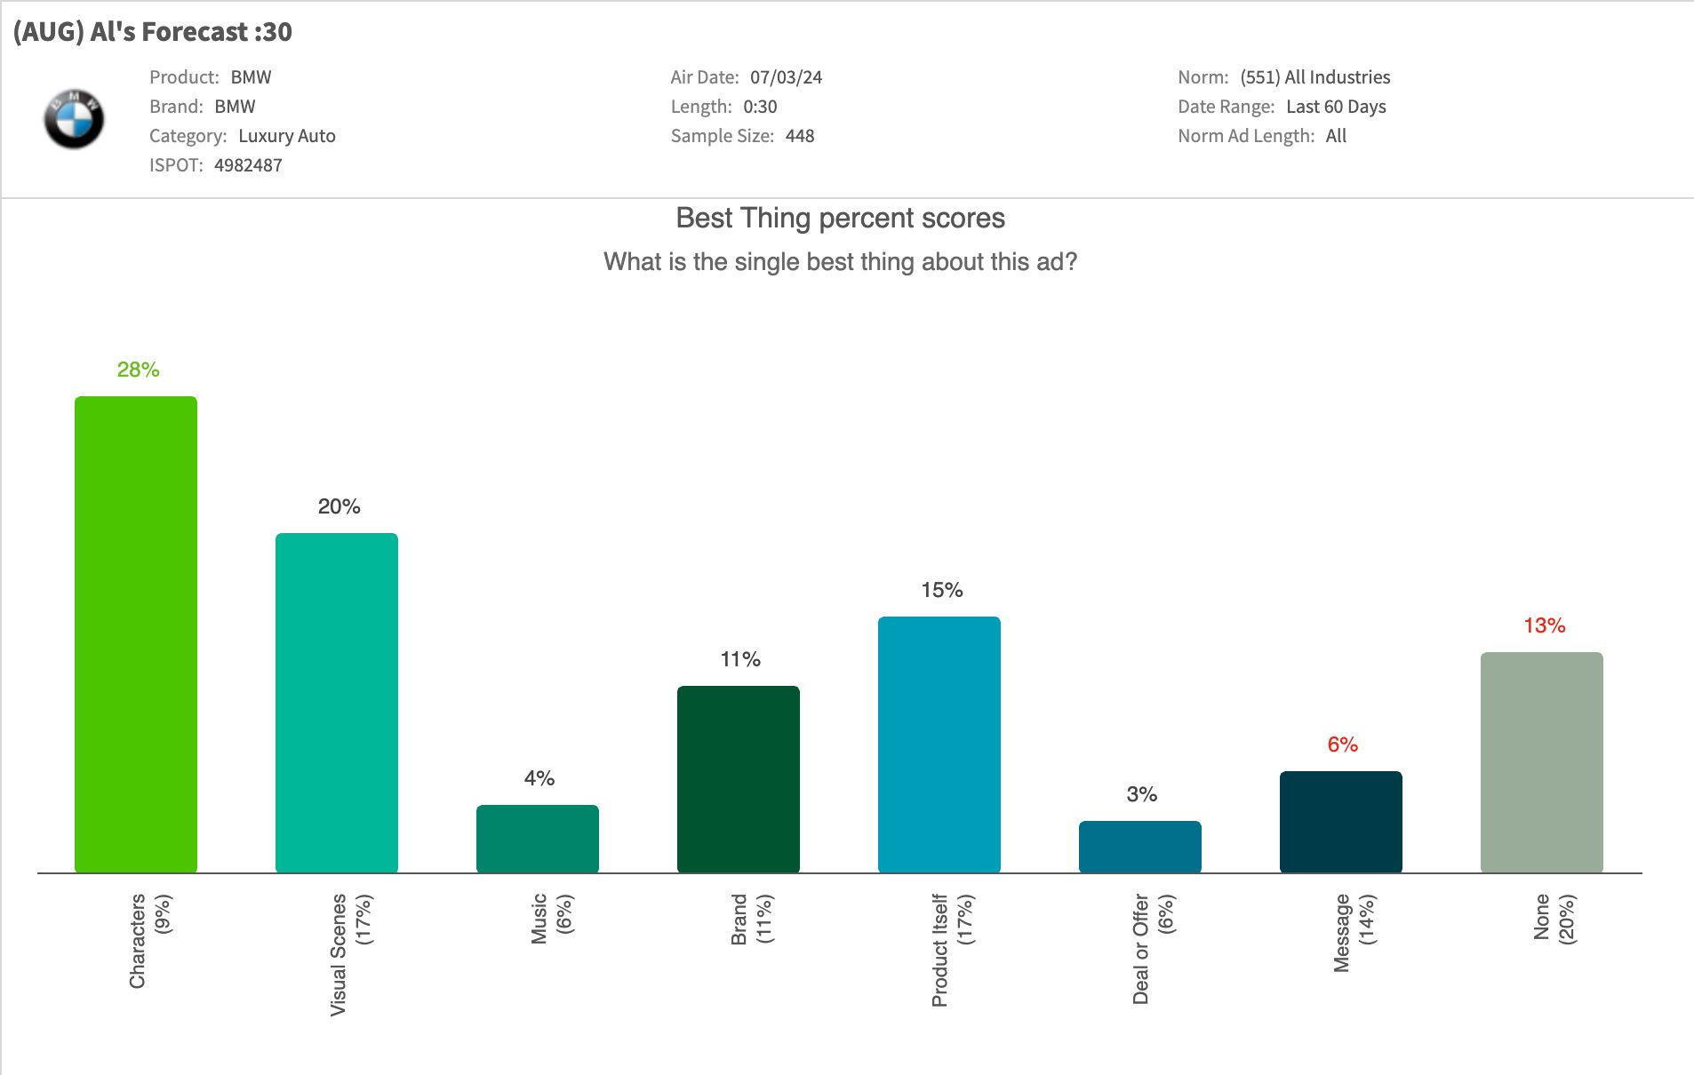
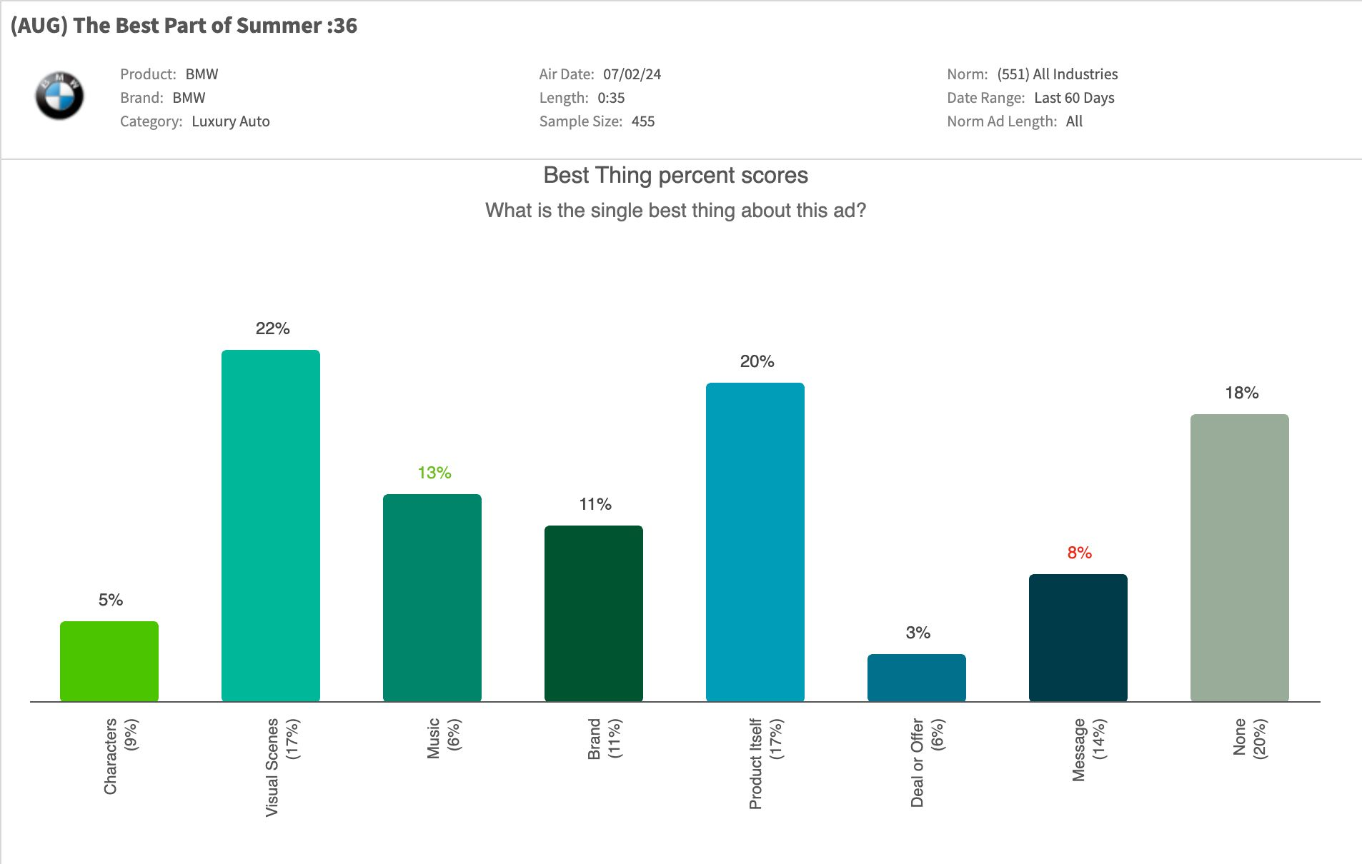
OUR SPOTS COMPLIMENT EACH OTHER WITH SUMMER IS ALL YOURS HAVING A MEMORABLE CHARACTER & BEST PART OF SUMMER SHOWCASING OUR PRODUCT WELL.
Characters
Product
Page 29
Notes:
Each of our spots do different things. One tells a good story with a memorable character, while the other showcases product. So they work well together.
A COMPLEMENTARY COMBINATION: STORY AND PRODUCT

Slide 30

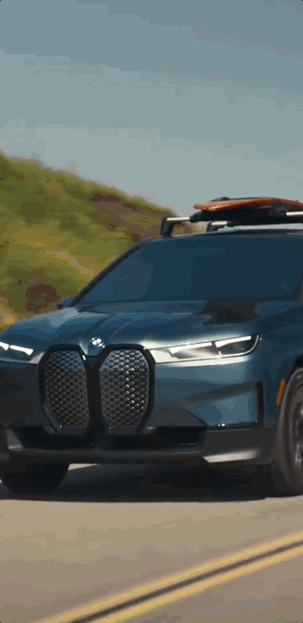
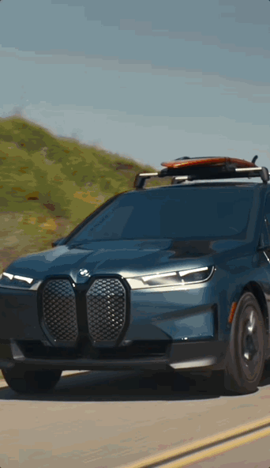
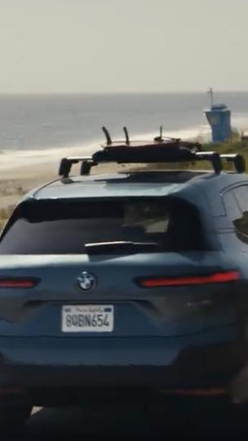



TVC ORGANIC SOCIAL POSTS.
INSTAGRAM 7/2
FACEBOOK 7/2
LINKEDIN 7/2
Cutdown TVC posts earned the highest impressions and engagements rate on Instagram while Facebook was the only channel to post negative sentiment.
TOTAL IMPRESSIONS:
132,533 +83,588
TOTAL ENGAGEMENTS:
2,499 +186
Link
Link
Link
Total Impressions: 95,302
Total Engagements: 1,811
Eng. rate: 1.90%
Net Sentiment: 40%
(60% pos, 20% Neu, 20% Neg)
Total Impressions: 30,261
Total Engagements: 290
Eng. rate: 0.96%
Net Sentiment: -15%
(35% pos, 14% neu, 50% neg)
Total Impressions: 6,990
Total Engagements: 398
Eng. rate: 5.57%
Net Sentiment: 100%
(100% pos)
2024 SSE Campaign | Bi-Weekly Report #3

Slide 31
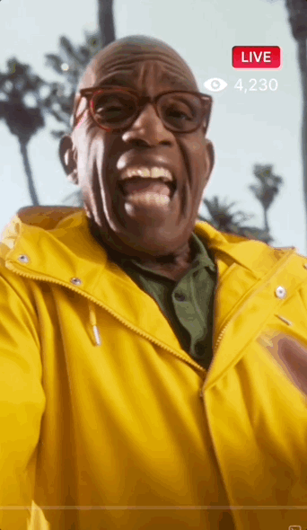




180 ORIGINAL CONTENT POSTS.
INSTAGRAM 7/8
TIKTOK 7/8
INSTAGRAM 7/12
TIKTOK 7/12
The original content for TikTok earned the highest engagement rate across all organic – while AMSR on Instagram earned the highest impressions.
TOTAL IMPRESSIONS:
202,004 +134,475
TOTAL ENGAGEMENTS:
5,152 +1,851
Link
Link
Link
Link
Total Impressions: 86,990
Total Engagements: 1,170
Eng. rate: 1.34%
Net Sentiment: 71%
(78% pos, 12% Neu, 7% Neg)
Total Impressions: 4,978
Total Engagements: 423
Eng. rate: 9.09%
Net Sentiment: 70% (70% pos, 30% neu, 0% neg)
Total Impressions: 101,805
Total Engagements: 2,266
Eng. rate: 2.23%
Net Sentiment: 81%
(81% pos, 19% Neu, 0% Neg)
Total Impressions: 8,231
Total Engagements: 893
Avg Eng. rate: 10.8%
Net Sentiment: 61%
(70% pos, 22% Neu, 9% Neg)
2024 SSE Campaign | Bi-Weekly Report #3

Slide 32

180 ORIGINAL CONTENT POSTS.
INSTAGRAM 8/14
Facebook 8/14
LinkedIn 8/14
Our image carousels posted in 8/14 featuring iX saw lower engagement on IG and Facebook while doing better on LinkedIn.
TOTAL IMPRESSIONS:
56, 058
TOTAL ENGAGEMENTS:
2,673
Link
Link
Link
Total Impressions: 33,054
Total Engagements: 2,281
Eng. rate: 6.9%
Total Impressions: 17,262
Total Engagements: 262
Eng. rate: 3.6%
Total Impressions: 5,742
Total Engagements: 130
Eng. rate: 11.4%
2024 SSE Campaign | Bi-Weekly Report #3

Slide 33

180 ORIGINAL CONTENT POSTS.
INSTAGRAM 8/21
Facebook 8/21
Linkedin 8/21
Our final SSE carousel featuring X5 post did well, garnering high engagement across channels – with standout performance on LinkedIn at an almost 20% Engagement Rate.
TOTAL IMPRESSIONS:
91,504
TOTAL ENGAGEMENTS:
5,203
Link
Link
Link
Total Impressions: 56,447
Total Engagements: 4,607
Eng. rate: 8.16%
Total Impressions: 28,581
Total Engagements: 425
Eng. rate: 5.6%
Total Impressions: 6,476
Total Engagements: 171
Eng. rate: 19.9%
2024 SSE Campaign | Bi-Weekly Report #3

Slide 34











Phase 1 creative in market.
EV & ICE TV/OLV TAGS
EV & ICE SOCIAL VIDEOS
EV & ICE PINTEREST
180 ORGANIC & PAID SOCIAL VIDEOS
2024 SSE Campaign | Bi-Weekly Report #3

Slide 35











PhASE 1 creative in market.
SOCIAL CAROUSELS
BYO SOCIAL STATICS
EV & ICE DISPLAY BANNERS
2024 SSE Campaign | Bi-Weekly Report #3

Slide 36


Phase 2 creative in market.
EV & ICE TV/OLV TAGS
EV & ICE SOCIAL VIDEOS
EV & ICE PINTEREST
180 ORGANIC & PAID SOCIAL VIDEOS
2024 SSE Campaign | Bi-Weekly Report #3

Slide 37



PhASE 2 creative in market.
SOCIAL CAROUSELS
BYO SOCIAL STATICS
EV & ICE DISPLAY BANNERS
2024 SSE Campaign | Bi-Weekly Report #3

Slide 38
































July 2024 sse flowchart.
Campaign | Channel | 2 (Campaign Launch) | 7 | 14 | 21 | 28
National
 | Video*
 | Audio
 | Display
 | OOH
 | Social
 | Search
T2
 | Video*
 | Audio
 | Display**
 | Social
 | Search
* Video consist of linear, streaming and OLV
** T2 Display, Video Publishers listed are a sample site list bought programmatically
2024 SSE Campaign | Bi-Weekly Report #3

Slide 39
AUGUST 2024 sse flowchart.
Campaign | Channel | 28 | 4 | 11 | 18 | 25
National
 | Video*
 | Audio
 | Display
 | OOH
 | Social
 | Search
T2
 | Video*
 | Audio
 | Display**
 | Social
 | Search
Creator
* Video consist of linear, streaming and OLV
** T2 Display, Video Publishers listed are a sample site list bought programmatically
2024 SSE Campaign | Bi-Weekly Report #3

Slide 40
CRM PERFORMANCE SUMMARY
Overall Results
EV Performance
Winback EM4
EV messages are garnering higher CTR levels YoY across all audiences
In-Market Owners (+0.6 pts higher), Handraisers (+0.56 pts higher) and Lead (+0.85 pts higher) observing the highest improvement
i4 Offer Details CTA is receiving 1.3x more clicks than the iX Offer Details CTA
EM4 to Winback audience was well received. It generated 1.4x higher engagement than the ‘24 SSE campaign aggregate, with 8x fewer unsubscribes
This touchpoint also generated the second most leads amongst EV touchpoint of 11.1k
SSE ‘24 emails haven't outperformed YoY engagement performance yet , except Lead audience by +0.29 pts
Leads and Sales conversion volume is pacing more in-line when compared YoY, though additional time is needed for data to mature.
Notes:
Winback: 75% of Click volume (2023) already achieved in 2024
Winback: ICE CTR ~7x lower in 2024 vs. 2023

Slide 41


Overall 2024 SSE PERFORMANCE-TO-DATE (AS OF 08/22)
Data window for 2024 results-to-date: 7/12 – 8/24

Slide 42


EV 2024 SSE PERFORMANCE-TO-DATE (AS OF 08/22)
Data window for 2024 results-to-date: 7/12 – 8/24

Slide 43

New touchpoint for SSE '24
Data window: 7/12 – 8/24

